Slide 1
The Rise of Industrial America
1877-1914

Slide 2
US.1
Explain patterns of agriculture and industrial development as they relate to climate, use of natural resources, markets and trade, the growth of specialized industries such as textiles, automobiles, and steel.

Slide 3
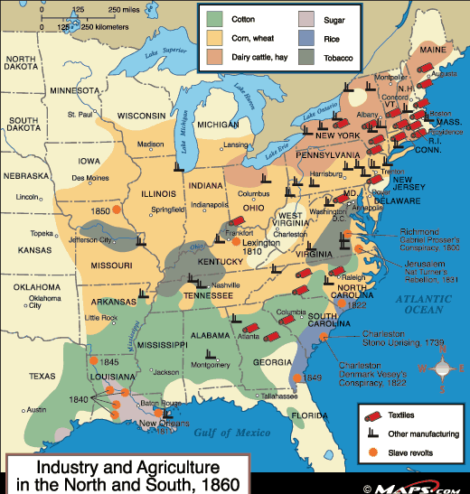

Slide 4
The New South
5-10 yrs. after the Civil War
Economic Structure
Wealthy – Lower
Large upper class
Very few middle class
High # in poverty
Many economic problems

Slide 5
Economic Structure (Con’t)
Carpetbaggers- Northerners that moved South after the war for personal financial gain (ex. Use black votes to gain office)
Scalawag- Southern whites that support the Republicans (scrawny worthless animal)

Slide 6
Economic Structure (Con’t)
Black people & poor whites
Earning a living
Competition for jobs
Sharecropping-
poor person provides labor
Wealthy land owner provides land & supplies at high interest rate
Each gets about ½ to 1/3 crop harvest (not much of a living)
Tenant Farmer- people paid cash to rent land for farming
Result: former slaves gaining more independence

Slide 7
Iron, Coal, and Steel
Many visionaries in the south felt agriculture along with mills and factories could bring prosperity back to the region
Before the war, raw materials from the South were shipped to the Northeast or abroad
If southern planters could bring the finishing industries south, they stood a good chance

Slide 8
The Clinchfield Syndicate: Early Visionaries For East Tennessee

Slide 9
The New South
After Reconstruction ended, the South struggled to develop industry
In some areas (like the Tri-Cities to some degree) industrialization had success, but for the most part it was hindered for many reasons
As a result the South remained largely agricultural and poor

Slide 10
Textiles! Cigars! Lumber! Oh My!
In the 1880’s textile factories (backed by Northern investors) begin to pop up in the south
Cigar and lumber production (the real cause of the Hatfield/McCoy feud) also begin to take shape
Coal-, Iron- and Steel-processing industries start in many southern cities

Slide 11
Timber In The Area

Slide 12
Local Examples
Big Jack Overalls-Bristol- now makes Pointer Brand overalls
Kleen smoke Pipe Company- JC
Tennessee Lumber and Veneer Plant -JC
Tennessee Silk Mill in Kingsport
Southern Potteries- Erwin – Makes Blue Ridge Pottery
North American Rayon in Elizabethton
Red Band Flour Mill- “Kitchen Tested”- JC
Johnson City Mill- made children’s cotton stocking

Slide 13
Red Band Flour Blue Ridge Pottery

Slide 14
Railroads Once Again Link
Transporting the raw material to their processing plants was a key element to the process
Southern rail lines expand, and rural areas are now linked to hubs like Mobile Alabama, New Orleans, Charleston..dare I say Johnson City and Bristol
Only two rail lines linked the south to the north

Slide 15
Our Old Friend the ET&WNC

Slide 16
Limited Economic Recovery
While the North could keep it’s industry going, the South had to rebuild after the war- THEN get it’s industry going
Locally industry lagged behind, and never really met the growth of places like Birmingham, Nashville or even Knoxville

Slide 17
The Three Legged Stool
Natural Resources: coal, iron ore, timber- basic elements needed for a finished good
Labor: people to a) harvest the natural resources and b) process them into finished goods
Capitol Investment: money to buy natural resources and process them into finished good

Slide 18
The South Lacks
While the south has an abundance of natural resources, it lacks in skilled labor and investments
Economic Development requires skilled labor and consumers who can spend

Slide 19
US.2
Summarize the major developments in Tennessee during the Reconstruction era, including the Constitutional Convention of 1870, the yellow fever epidemic of 1878, and the election of African Americans to the General Assembly.

Slide 20
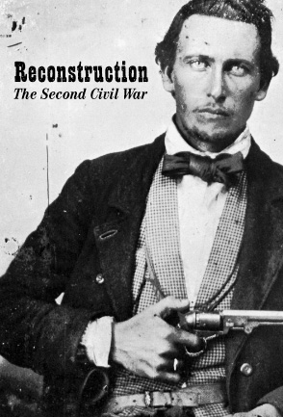
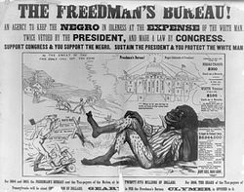
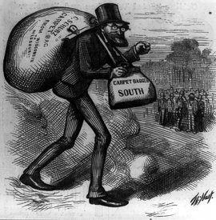
Reconstruction

Slide 21
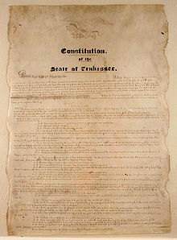
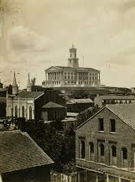
Constitutional Convention of 1870

Slide 22
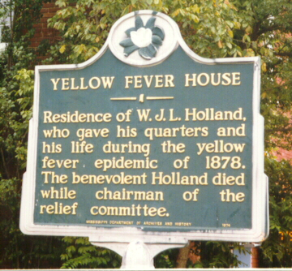
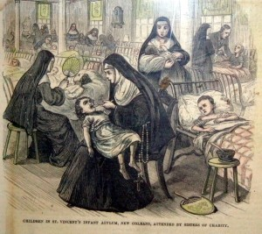
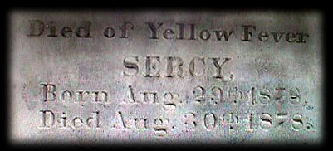
Yellow Fever - 1878

Slide 23
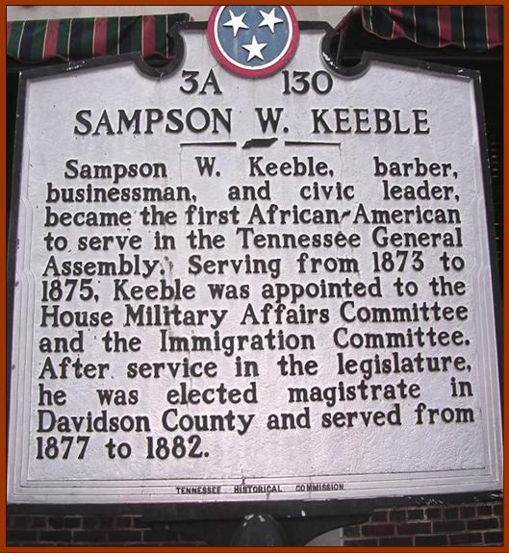
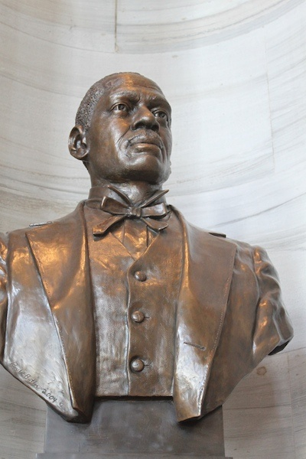
African Americans in the General Assembly

Slide 24
US.3
Explain the impact of the Hayes-Tilden Presidential election of 1876 and the end of Reconstruction on African Americans, including Jim Crowe laws, lynching, disenfranchisement methods, efforts of Pap Singleton and the Exodusters

Slide 25
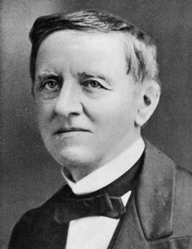
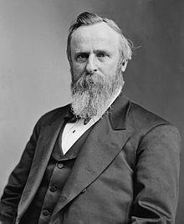
Election of 1876
Samuel J. Tilden
Rutherford B. Hayes

Slide 26
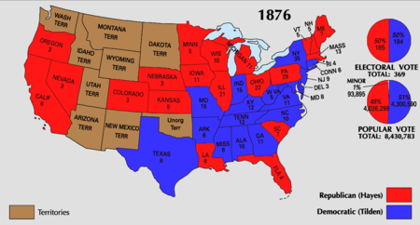
Election of 1876

Slide 27
Election of 1876
Samuel J. Tilden (Democrats)
Rutherford B. Hayes (Republican)
Election was filled with fraud and intimidation
Tilden ends up with mot of popular vote, but did not have enough electoral votes
Electoral Votes
185 Tilden
184 Hayes
Results changed
Special commission set up in congress
8-7 voted in favor of Hayes
Had more Republicans than Democrats
South goes crazy “15”
Hayes selected as president

Slide 28
Compromise of 1877
Democrats agreed not to challenge the commission’s Results
Rutherford B. Hayes became 19th President
Federal troops would be removed from the South
Federal money would be given to the South for improvements
Railroads, levees, other infrastructure
Formal end to Reconstruction

Slide 29
South Returns to Ways similar to Pre- Civil War Era
White Supremacy
Few rights for African Americans
Big difference- no more slavery

Slide 30
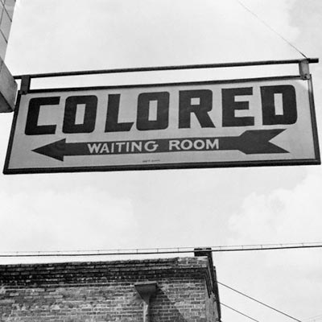
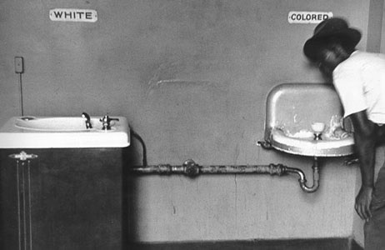
Jim Crow Laws

Slide 31
SEGREGATION AND SOCIAL TENSIONS
During Reconstruction, the Federal Government sought to secure equal rights for African Americans
By the Gilded Age minorities experienced a narrowing of their rights
This trend had a lasting impact on society in the U.S for many many years to come

Slide 32
Disenfranchisement of Voters
Following the election of 1876, federal troops were removed from the South
This allowed southern states to reassert their powerful control over African Americans without Federal intervention
Most southern government enacted various measures aimed at the disenfranchising African Americans
Also Jim Crow laws began appearing that segregated blacks and whites

Slide 33
The World of Jim Crow
Methods of Oppression
#1 concern---right to vote--- afraid blacks would gain too much power
In order to vote:
Must own property or pay a poll tax: fee one must pay in order to vote.
This was beyond the means of most African Americans
Literacy Test: knowledge based test designed to keep African Americans from voting. (Whites were given easier test)
Grandfather clause: you do not have to take exams or pay poll taxes if your grandfather voted.

Slide 34
Poll Tax
Requires voters to pay a tax in order to vote; The tax cost voters $1 or $2 to vote. Poor African Americans could not afford the fee, therefore this was an effective method used by white southerners to keep blacks out of southern politics.
Closure Question #1: In what ways were the rights of African Americans restricted? (At least 2 answers and 2 complete sentences.)

Slide 35
Literacy Tests
Examinations to determine whether or not a person can read and write; in the late 19th century, Southern states passed laws requiring voters to pass literacy tests in order to vote. Many freed slaves, who were forbidden to learn to read prior to the Civil War, were kept from voting as a result.
Closure Question #1: In what ways were the rights of African Americans restricted? (At least 2 answers and 2 complete sentences.)

Slide 36
Grandfather Clauses
Voting laws enacted in southern states which allowed a person to vote as long as his ancestors had voted prior to 1866. Of course, the ancestors of the black freedmen did not vote prior to 1866.
Closure Question #1: In what ways were the rights of African Americans restricted? (At least 2 answers and 2 complete sentences.)

Slide 37
The World of Jim Crow
Jim Crowe Laws: system of laws that segregated blacks and whites. Late 1800’s primarily in the South.
Forces use of separate and unequal facilities
Examples: schools, barbers, hospitals, transportation
Plessy v. Ferguson: Legalized separate but equal
Homer Plessy in Louisiana
African American facilities still not equal
Violence: lynching from 1880-1940 4000 blacks killed in this manner
Sometimes lynching’s advertized in newspapers
Done because of reasons like too prosperous, looked at white woman, talked back to someone etc…

Slide 38
The World of Jim Crow
De Facto Discrimination: Generally took place in the North. It was a type of discrimination that existed in fact but not in law (results of customs) i.e. schools housing, employment

Slide 39
Examples of Jim Crow Laws
Florida- "All marriages between a white person and a Negro, or between a white person and a person of Negro descent to the fourth generation inclusive, are hereby forever prohibited."
New Mexico- "Separate rooms [shall] be provided for the teaching of pupils of African descent, and [when] said rooms are so provided, such pupils may not be admitted to the school rooms occupied and used by pupils of Caucasian or other descent."
Virginia- "Every person... operating... any public hall, theater, opera house, motion picture show or any place of public entertainment or public assemblage which is attended by both white and colored persons, shall separate the white race and the colored race and shall set apart and designate... certain seats therein to be occupied by white persons and a portion thereof, or certain seats therein, to be occupied by colored persons."
Alabama- "All passenger stations in this state operated by any motor transportation company shall have separate waiting rooms or space and separate ticket windows for the white and colored races."
Georgia- "It shall be unlawful for any amateur white baseball team to play baseball on any vacant lot or baseball diamond within two blocks of a playground devoted to the Negro race, and it shall be unlawful for any amateur colored baseball team to play baseball in any vacant lot or baseball diamond within two blocks of any playground devoted to the white race."

Slide 40
Jim Crow In Pictures

Slide 41
Limitations On Voting Rights
The Fifteenth Amendment (1870) prohibited state government from denying someone the right to vote because of “race, color, or previous condition of servitude.”
After Reconstruction states got around this by passing measures that limited voting
Such measures would be things like a poll tax or literacy test, or creating all-white primaries
Many African Americans, because they had been exploited economically, and denied education, were disqualified to vote by these measures

Slide 43
The Choke’em Down Lunchroom

Slide 44
The Grandfather Clause
Southern states also enacted the Grandfather Clause which allowed a person to vote so long as their ancestor have voted prior to 1866
While this is a nice gesture, why could African Americans still not vote?
In addition, whites begin to resort to violence to keep African Americans from participation in the political process

Slide 45
Senator Ben Tillman of South Carolina
“We have done our level best. We have scratched our heads to find out how we could eliminate the last one of them (black voters). We stuffed ballot boxes. We shot them.”

Slide 46
As a result, throughout the Deep South, black participation in politics falls dramatically.
For example in Louisiana the number of black registered to vote fell from 130,000 in 1894 to just over 1,300 in 1904
Only 3% of all African Americans could vote in 1940….the eve of World War Two where many African Americans would fight and die for their country

Slide 47
The Original Jim Crow

Slide 48
Initially, some white southerners opposed Jim Crow laws on the grounds that if some aspects of life were segregated, then eventually all would be
One Charleston, SC newspaperman said “If there must be Jim Crow cars (RNR), there should be Jim Crow waiting saloons. And if there are Jim Crow saloons, then there would have to be Jim Crow jury boxes, and a Jim Crow Bible for colored witnesses.

Slide 49
Examples of Things That Were Segregated Under Jim Crow Laws
In the South: jury boxes, Bibles, beaches, boarding houses, parks, water fountains, saloons, restaurants, hospitals…almost everything everything
In the North many states, where Jim Crow laws we illegal, many blacks migrants found that segregation was still present.
Many faced unwritten codes restricting where they could live and work

Slide 50
Plessy v. Ferguson
In Plessy v. Ferguson, the U.S Supreme Court upheld the constitutionality of Jim Crow laws by arguing that so long as states maintained “separate but equal” facilities they did not violate the Fourteenth Amendment

Slide 51
Even though blacks were seen as second-class citizens, they continued to participate in many of the same activities that whites did
The established newspapers like the Black Press, fraternal clubs like the Prince Hall Freemasons, schools and colleges like Grambling and The Tuskegee Institute in Alabama

Slide 52
Resistance to Reconstruction
Formation of Secret Organizations for the purpose terror & intimidation
Pale Faces
Sons of Midnight
Knights of the White Camellia
Ku Klux Klan (KKK)
Goal maintain white supremacy and prevent African Americans from exorcising their rights

Slide 53
Resistance to Reconstruction
Christmas Eve 1865 6 confederate soldiers met in Pulaski, TN
1st leader Nathan Bedford Forrest “The Grand Wizard”
1st goal frighten blacks in middle of night. Wore white sheets & hoods pretending they were dead rebel soldiers
Soon turn to violence ex. Beating, lynching , burnings, (violence works keeps blacks away from Polls)

Slide 54
Resistance to Reconstruction
Why you might receive a visit
Not being polite
Becoming involved in politics
Dressing well
Raising a good crop
Teaching black students
Sharecroppers & shares
Refusing to do work
A republican
Government passes KKK Acts designed to break the Klan (lasted 6 months)

Slide 55
Goals
1. Frighten African Americans
(Middle of Night- Ghosts of Confederate Soldiers)
Turned to violence- ex: Beatings, Lynching, Cross Burnings
2. Keep African Americans from voting

Slide 56
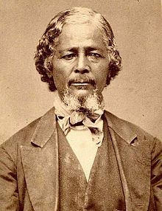
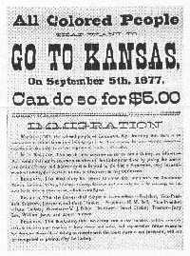
Pap Singleton and the Exodusters

Slide 57
The Exodusters:
name given to the thousands of African Americans fleeing west to escape the violence & racism of the South. (mass exodus: Israelites flight from Egypt)

Slide 58
Exodusters
Many of these westward immigrants were freed slaves that left the South in search of cheap land and new start on life
Benjamin Singleton, a former slave from Tennessee, organized a group of these former slaves and called them the Exodusters
Taking their name from the Bible, their “Promised Land” was Kansas and Oklahoma

Slide 59
Benjamin Singleton His Exodusters

Slide 60
US.4
Analyze the causes and consequences of Gilded Age politics and economics, including the rise of political machines, major scandals, civil service reform, and the economic difference between farmers, wage earners, and industrial capitalists, including the following:
Boss Tweed, Thomas Nast, Credit Mobilier, Whiskey Ring, Garfield’s assassination, Pendleton Act

Slide 61
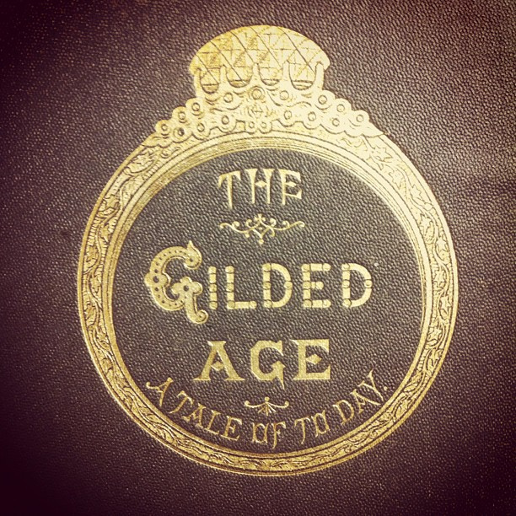

Slide 62
Gilded Age
Describes post-Reconstruction era in American society. Known for corruption & scandal. (coined by Mark Twain)
Gilded: actually means a thin layer of gold
It was a golden period for America’s industrialists
Immigrants, farmers, & factory workers did not fair as well

Slide 63
The Gilded Age
In 1873, Mark Twain satirized American life in his book “The Gilded Age” (Satirize: to make fun of by over exaggeration)
His depiction was that over a country rotten to the core, yet covered in gold

Slide 64
Mark Twain

Slide 65
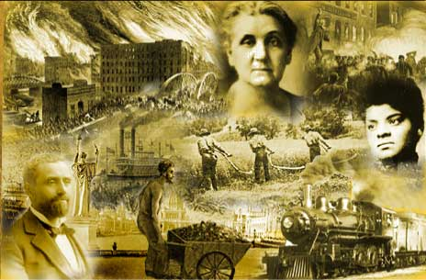

Slide 66
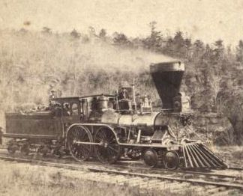
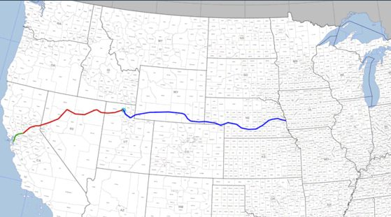
Railroads Link the Nation
1865 – 35,000 miles
1900 – 200,000 miles
Transcontinental Railroad
Union Pacific – Irish
Central Pacific - Chinese

Slide 67
Getting Started
In 1863 The Central Pacific started laying track heading eastward near Sacramento, California
At the same time the Union Pacific started laying track heading westward at Omaha, Nebraska

Slide 68
A Very Simple Map Of The Railroad Line

Slide 69
Immigrants and Their RNR Companies
Chinese
Irish
Central Pacific
Union Pacific

Slide 70
Chinese and Irish Workers

Slide 71
Driving The Golden Spike
The two track met at Promontory Point, Utah on November 6, 1869
The RNR connected the United State like it had never been connected before
Towns and cities sprung up along the line and at stops
A negative side effect was the growing demand for Indian land

Slide 72
The Final Tracks Are Laid

Slide 73
POLITICS IN THE GILDED AGE
As cities grew in the late 19th century, so did political machines
Political machines controlled the activities of a political party in a city
Ward bosses, precinct captains, and the city boss worked to ensure their candidate was elected

Slide 74
ROLE OF THE POLITICAL BOSS
The “Boss” (typically the mayor) controlled jobs, business licenses, and influenced the court system
Precinct captains and ward bosses were often 1st or 2nd generation immigrants so they helped immigrants with naturalization, jobs, and housing in exchange for votes
Boss Tweed ran NYC

Slide 75
MUNICIPAL GRAFT AND SCANDAL
Some political bosses were corrupt
Some political machines used fake names and voted multiple times to ensure victory (“Vote early and often”) – called Election fraud
Graft (bribes) was common among political bosses
Construction contracts often resulted in “kick-backs”
The fact that police forces were hired by the boss prevented close scrutiny

Slide 76
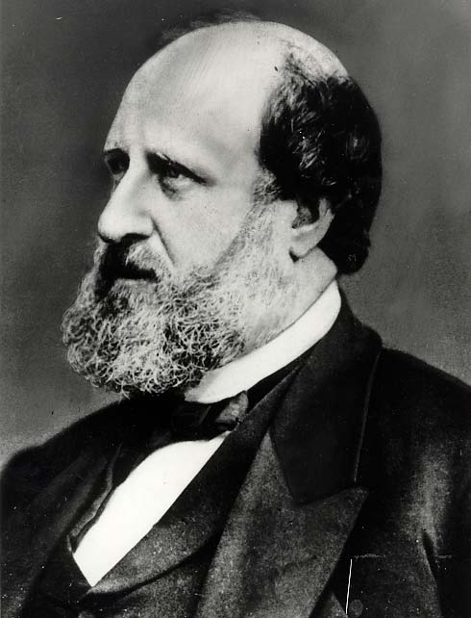
THE TWEED RING SCANDAL
William M. Tweed, known as Boss Tweed, became head of Tammany Hall, NYC’s powerful Democratic political machines
Between 1869-1871, Tweed led the Tweed Ring, a group of corrupt politicians, in defrauding the city
Tweed was indicted on 120 counts of fraud and extortion
Tweed was sentenced to 12 years in jail – released after one, arrested again, and escaped to Spain
Boss Tweed

Slide 77
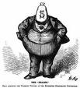
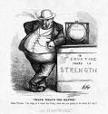
William Tweed
Closure Question #1: What factors contributed to the refocusing of the nation away from the problems of the South?
New York Democrat and Senator who came to became a symbol for the political corruption of the 1870s; in 1873 Tweed and other New York politicians were charged, convicted, and sentenced to prison for stealing millions of dollars from the New York City treasury.
Accusations of political corruption were made in both state and federal governments in the post-Civil War Era. Even Ulysses S. Grant, former Union General and President from 1869 to 1877, was accused of using his position to enable untrustworthy friends and acquaintances to steal money from taxpayers. Grant’s Vice-President, Schuyler Colfax, and brother were implicated in corruption schemes.
Thomas Nast, a New York journalist and cartoonist, was one of the key figures in exposing political corruption. Through his drawings he attacked the major political and social issues of the post-Civil War period. He is considered by some to be the father of the American political cartoon.

Slide 78
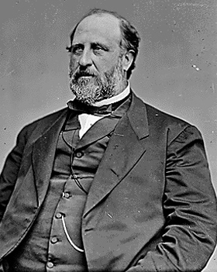
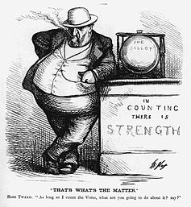
Boss Tweed

Slide 79
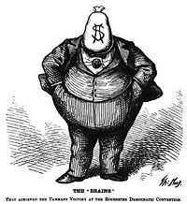
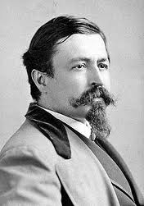
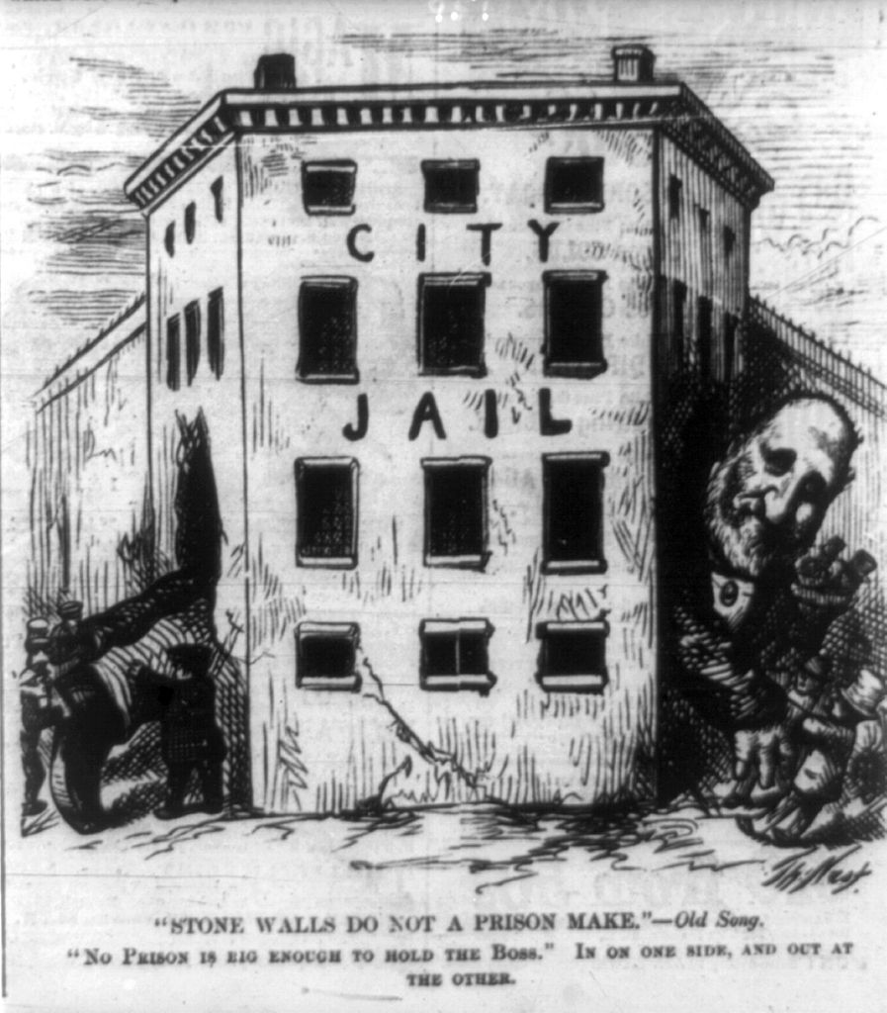
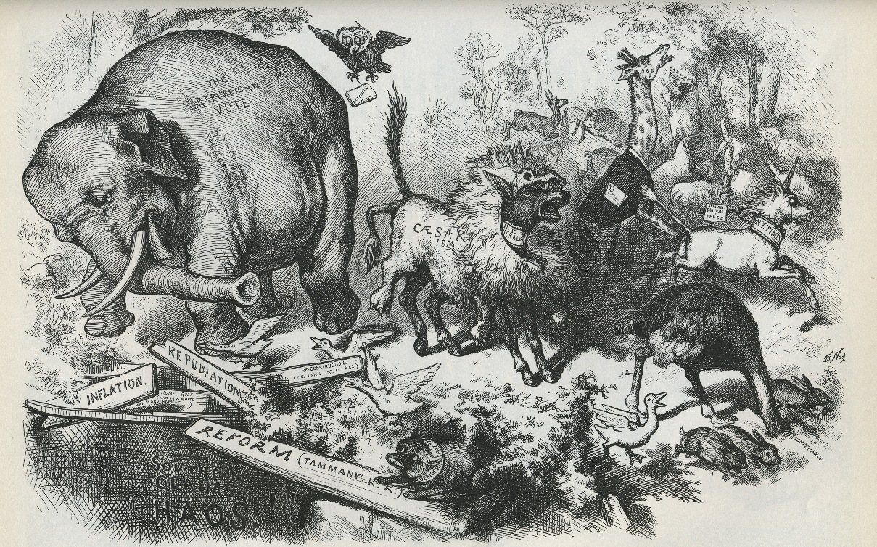
Thomas Nast

Slide 80
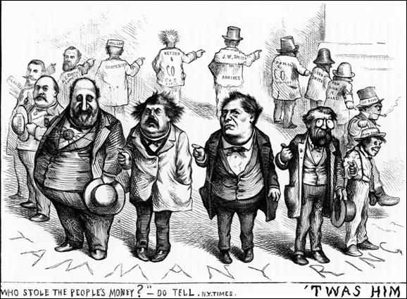

Slide 81
Scandal
The government was full of dishonest & unqualified people. Why?
Spoils System: used by Democrats and Republicans elected officials appoint friends & supporters to government jobs. Regardless of qualifications

Slide 82
Scandal
Credit Mobilier: Congress wanted Railroads built Congress gave Railroad Union Pacific loans and money to build railroads. Union Pacific hired Company Credit Mobilier to build. Credit Mobilier over charged & was paid 94 million (actually worth 44 million)
Shares of Credit Mobilier were given to Congressmen & VP to keep money flowing
Many other scandals during Grant Administration

Slide 83
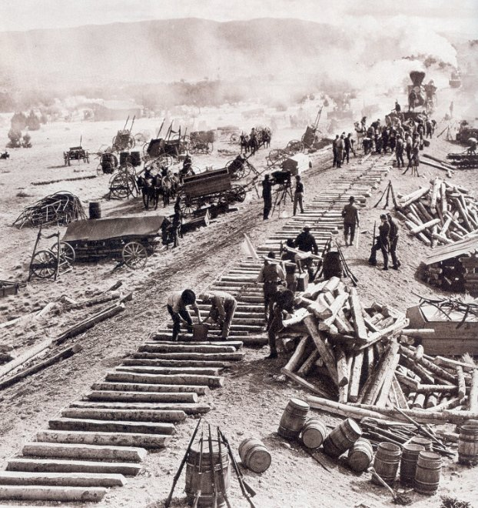
Credit Mobilier
Union Pacific RR overcharged for construction & bribed govt. officials, members of congress, and the vice president

Slide 84
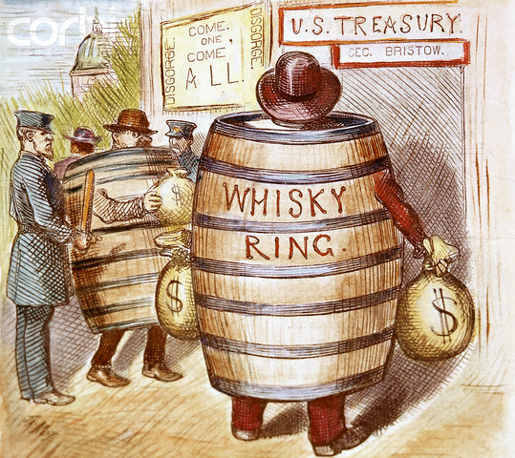
Whiskey Ring
Distillers bribed govt. officials to avoid paying heavy taxes

Slide 85
The Spoils System
A good simple definition is this: The spoils system is when government officials give jobs or favors to their buddies in return for political loyalty

Slide 86
Would you as president have defended the Spoils System. Why?

Slide 87
Rutherford B. Hayes

Slide 88
Rutherford B Hayes: did not
Civil service: name given to those working in the government that have not been elected, but were appointed.
Hayes actually appoints qualified people
Fires people that are not needed
Did this without the support of Congress or his party did not worry he would not seek reelection
Strengthened the American Government weakened the Republican Party.

Slide 89
Civil Service Reform
Pendleton Civil Service Act of 1883
Established the Civil Service Commission
Establish exams for those seeking government jobs
Intended to help make the Civil Service more competent

Slide 90
Do Nothing Congress
Party Loyalties were so evenly divided that no single group could gain any control of the House or Senate
Only twice between 1877 and 1897 did either the Republican (Rep.) or Democrats (Dem.) gain control of the White House and both houses of Congress
Neither times did this last for more than two years

Slide 91
Two Major parties during Gilded Age: Democrats and Republicans (had near equal support)
Republicans
Industrialists, bankers, & eastern farmers
Strongest in North and upper Midwest
Tight money supply backed by gold
High tariffs
High pensions to union soldiers
Generous aid to railroads
Strict limit on immigration
Enforcement of blue laws: regulated certain private activities that some considered immoral
Blamed Democrats for the Civil War known as “Waving the bloody shirt”
Democrats
Less privileged people
Urban immigrants, laborers, southern planters, western farmers
Increased money backed by silver
Lower tariffs
Higher farm prices
Less government aid to big business
Fewer Blue Laws

Slide 92
Weak, Weak, Weak Especially Compared to Lincoln
After the tragedy of the Civil War, no President could match the service of Lincoln, but really these guys??
Ruther B. Hayes is elected by a secret deal
Benjamin Harrison loses the popular vote but wins the electoral college
Chester Arthur comes in after Garfield is shot, then doesn’t win the Rep. ticket in the next election

Slide 93
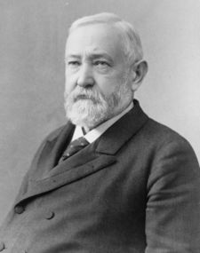
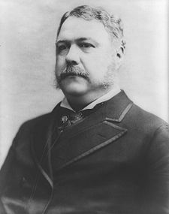
Who Are These Guys??

Slide 94
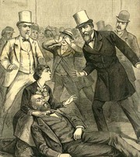
Garfield’s Assassination
Political Patronage (Spoils System)
Charles Guiteau…
Chester Arthur becomes president
Civil Service Reform
Pendleton Act

Slide 95
Chester Arthur:
became president when Garfield was killed. (Garfield was killed because of the spoils system).
Big stir over the spoils system begins
1883 Pendleton Service Act: classified government jobs and applicants must take and pass a test to meet criteria. (Civil Service)
Federal employees cannot be fired for Political reasons
Cannot be forced to contribute campaign funds

Slide 96
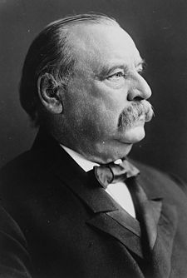
Grover Cleveland
The only President of note during this time is Cleveland
“A Democratic thief is as bad and a Republican theif”
The first Dem. to win the White House in 24 years

Slide 97
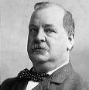
Grover Cleveland
The first Democrat to be elected President after the Civil War and the only President to be elected to two unconnected terms; Cleveland was President from 1885-1889 & 1893-1897 and, in an era known for its corruption, maintained a reputation for integrity.
Closure Question #1: Why do you think Congress became the strongest branch of the government in the 1880s? (At least 1 reason and 1 sentence)

Slide 98
Interstate Commerce Act

Slide 99
Interstate Commerce Commission (ICC)
Established in 1887 to oversee railroad operations; the first federal organization ever set up to monitor American business operations.

Slide 100
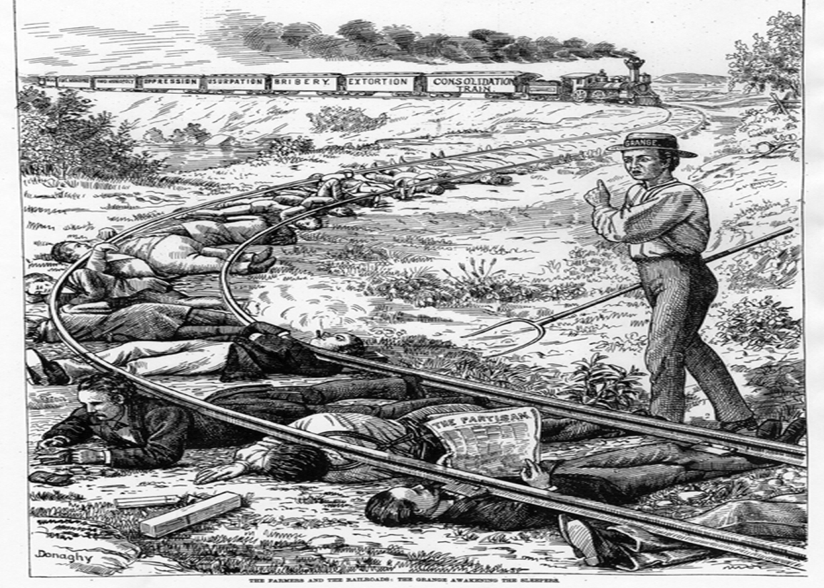
Interstate Commerce Act
Many states had what were called “Granger Laws”: state laws restricting excessive railroad freight rates and grain elevator storage rates
Overturned by the Supreme Court case Wabash v Illinois, 1886
Interstate Commerce Act of 1887
1st federal law to regulate interstate commerce
Required that railroads publicize shipping rates and prohibited short haul or long haul fare discrimination.
Law was not specific on maximum prices (“reasonable and just”) and was initially ineffective.
No enforcement provisions

Slide 101
US.5
Analyze the controversy that arose over the currency system in the late 1800’s, including the impact of gold and silver strikes in the West, the contrasting views of farmers and industrialists, the Sherman Silver Purchase Act of 1890, the Gold Crisis during the Cleveland administration, and an analysis of William Jennings Bryan’s Cross of Gold speech.

Slide 102
Politics and Currency:
Late 1800’s US economy was not in good shape
Farmers were suffering low prices
They had more supply than demand
Tariffs: tax on imports also hurt American farmers Why?
Raised prices on manufactured goods
Foreigners need not earn US dollars to buy crops
Tariffs favored eastern manufacturing not farming

Slide 103
Politics and Currency:
Period of deflation hurts farmers they want more money printed
Grange: organization founded by Oliver H. Kelly
Concerned with education & scientific farming
Social weekly gathering
Economic Co-Ops buy in large quantities & sell cheaper
Legal advice
NOT A POLITICAL PARTY

Slide 104
Politics and Currency:
Farmers Alliance: organization
Ask government to regulate RR monopolies
Call for inflation: issue more money
Government support prices
Political support for farmers
West and South is where power comes from

Slide 105
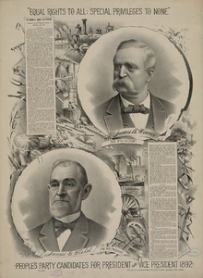
The Populist Party
After the limited success of the Grange organizations and the Farmer’s Alliances
Northern, Southern, Colored Farmer’s Alliances were regional
Farmers realized they needed a stronger political base.
They formed the Populist Party in 1892.

Slide 106
Politics and Currency:
The Populist Party:
increase circulation of money
call for control of RR system
endorse 8 hour work day
do away with Pinkertons as strike breakers
Progressive Income Tax
BY TURN OF CENTURY PARTY DIES BUT GOALS LIVE ON

Slide 107
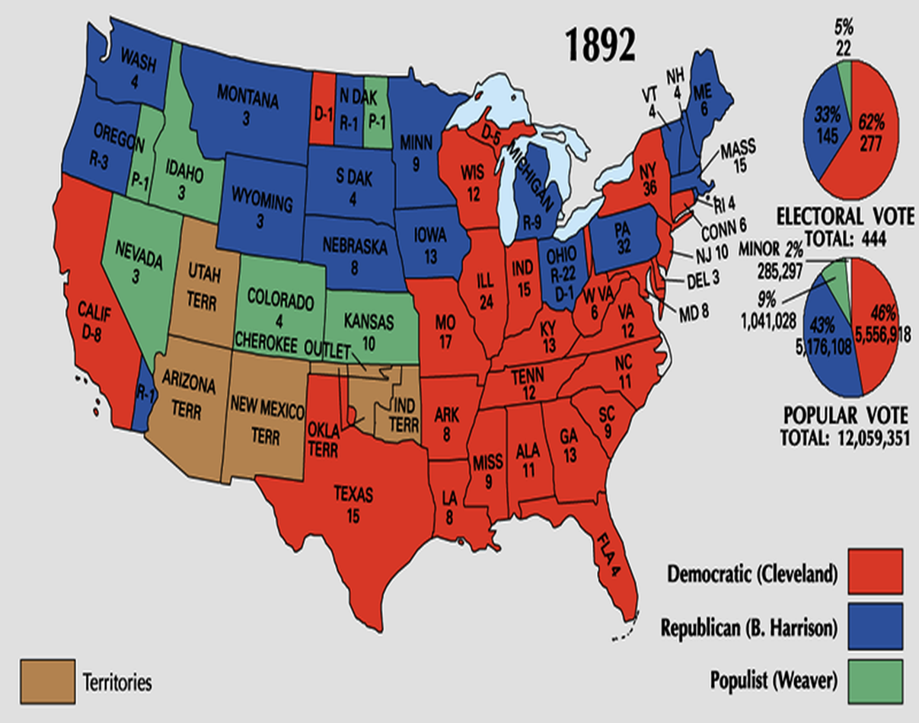
The Omaha Platform of the Populist Party
Gov’t control/regulation of RRs to prevent overcharging
Regulation of public utilities – telegraph & telephone
More money in circulation- more paper money & silver coins. (inflation)
Banking reform -better credit rates
Graduated income tax
Protect the “common man”

Slide 108
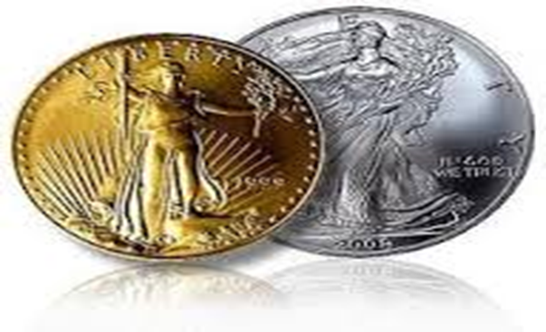
The Money Issue
19th century controversy over the currency system - whether the government would back paper money by:
(1) The Gold Standard - just use gold as currency (wealthy elites) OR
(2) Bimetallism “free coinage of Silver” - both gold AND silver as currency (common man)

Slide 109
The Issue
In the 19th century paper money was based on the amount of specie (precious metal) owned by the government.
If the government increased the money supply, the value of the dollar dropped resulting in inflation.
Farmers favored increasing the money supply (by using silver to back paper money) because the money they eventually pay back to the bank is worth less than the money they borrowed.
Farmers also favored inflation because it raises the prices of the goods they sell.
In contrast, if the government reduces the money supply (by only using gold to back paper money), the value of each dollar becomes greater and lowers the price of goods.
Good for industrial workers in the cities
Banks are helped by deflation because the money they receive in payment of a loan is worth more than the money they lent out.

Slide 110
The Money Question
“Gold Bugs” were eastern bankers & business owner industrialists
Effects
Less $ in circulation
Money’s value stays high
Prices fall (deflation)
Wages remain low
Less money available means an increased reliance on banks for loans
“Silverites” were farmers, silver miners, and common laborers
Effects
More $ in circulation
Money loses value (“cheap money”)
Prices go up (inflation)
Wages go up
More money available for credit and loans are easier to pay off

Slide 111
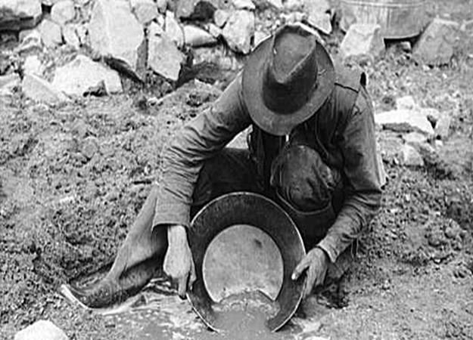
Money Laws of the 19th century
Coinage Act of 1873 – US went back to the gold standard
Farmers and miners called it the “Crime of 73”
Bland-Allison Act of 1878
US had to coin and circulate some silver
Prompted by silver discoveries in the West

Slide 112
The Sherman Silver Purchase Act of 1890
Required the US Treasury to purchase AND coin increased amounts of silver.
Added to the amount of money in circulation.
Law was passed in response to the growing complaints of farmers and miners.
Silver mine discoveries continued to increase the supply of silver which decreased its value compared to gold.
***Contributed to the gold crisis of the Cleveland administration.

Slide 113
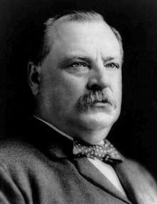
The Gold Crisis
As the silver supply increased, its value decreased and people began exchanging their silver dollars for gold dollars
drained the US Treasury’s gold supply.
Gold was the basis of international credit – other nations began to doubt the dependability of US currency.
President Grover Cleveland and Congress responded by repealing the Sherman Silver Purchase Act of 1890, but it was too late.
Result: The Panic of 1893

Slide 114
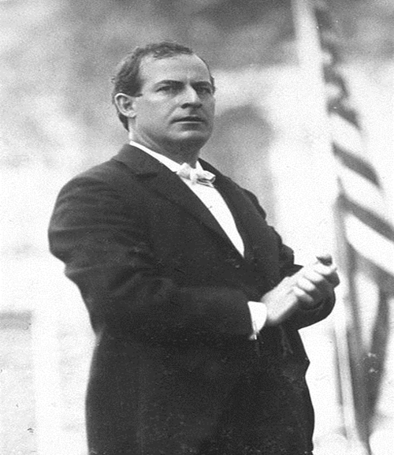
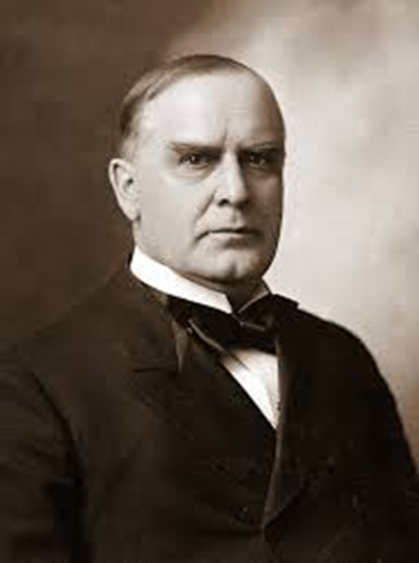
Election of 1896
Democrats: William Jennings Bryan
Cross of Gold speech
Republicans: William McKinley
Populists adopted the Democrat candidate William Jennings Bryan.
Was a contest of eastern big business vs western farmers

Slide 115
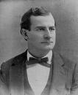
William Jennings Bryan
Democratic Nominee for President in 1896; Bryan supported Populist ideas and argued passionately for the Coinage of Silver in a speech known as “The Cross of Gold”. His defeat in the election signaled the downfall of Populism in the United States.
Closure Question #3: In what ways did McKinley represent the old way of politics? (At least 1 sentence) In what ways did Bryan represent the new way? (At least 1 sentence)

Slide 116
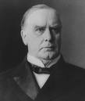
William McKinley
Republican Candidate for President in 1896; McKinley raised $15 million in campaign funds, 30 times the amount of his opponent William Jennings Bryan, and won the Presidency in 1896 and in 1900 by portraying his opponent as a potential dictator, leading to the fall of Populism.
Closure Question #3: In what ways did McKinley represent the old way of politics? (At least 1 sentence) In what ways did Bryan represent the new way? (At least 1 sentence)

Slide 117
Election of 1896
City dwellers abandoned Bryan
Inflation bad for industrial workers
McKinley wins Presidency (defeats Bryan in 1900 also)
Populists collapse

Slide 118
The Cross of Gold Speech
Having behind us the producing masses of this nation and the world, supported by the commercial interests, the laboring interests, and the toilers everywhere, we will answer their demand for a gold standard by saying to them: ‘You shall not press down upon the brow of labor this crown of thorns; you shall not crucify mankind upon a cross of gold.’
The reaction to the speech was a moment of silence followed by pandemonium with delegates raising Bryan to their shoulders and carrying him around the floor. Although he was not nominated that day, Bryan won the Democratic presidential nomination the following day on the fifth ballot on the strength of the “Cross of Gold” speech. However, none of the pro-gold delegates voted for Bryan. Even with support from the Populist Party and Silver Republicans, the defections of the Democratic gold-supporting delegates divided and weakened the Democratic Party for the general election contest between Bryan and McKinley.
Despite his defeat, Bryan’s speech is considered one of the most famous political addresses in American history.

Slide 119
US.6
Describe the changes in American life that resulted from the inventions and innovations of business leaders and entrepreneurs of the period:
Henry Bessemer, George Pullman, Alexander Graham Bell, Andrew Carnegie, Thomas Edison, J.P. Morgan, John D. Rockefeller, Swift and Armour, Cornelius Vanderbilt

Slide 120
The Growth of Big Business & Industry (Late 1800’s)
More goods & less expensive goods
More jobs
Public Works
Corrupt officials
Drained national resources
Poor pay
Destroy small business
Captains of Industry
Robber Barron’s

Slide 121
Examples of Both
Andrew Carnegie: Born in Scotland @ age 13 moved to US worked in factory at this age $1.20 a week paid workers low wages, established about 3000 libraries, gave away 350 million dollars. By 1900 he made 25 million a year without having to pay any income taxes. (with inflation that is worth about 650 million dollars a year today
Gospel of Wealth: people should be free to make as much money as you possibly can with little to government intervention and then give it away.

Slide 122
RAGS TO RICHES
THE RAGS TO RICHES IDEAL IS DEPENDANT ON CAPITALISM OR FREE ENTERPRISE
CAPITALISM: an economic system characterized by private or corporate ownership of capital goods, by investments that are determined by private decision
In other words: the people, not the state, owns everything

Slide 123
ENTREPRENEURS
ENTREPRENEURS: people who invest in a product or enterprise (often new and experimental) in order to make a profit
Once again IN OTHER WORDS: people who are out to make the big money

Slide 124
PROTECTIVE TARIFFS
TO ENCOURAGE AMERICANS TO BUY AMERICAN GOODS CONGRESS ENACTS TARIFFS
THESE TARIFFS RAISED THE PRICES OF FORGIEN GOODS IN ORDER TO MAKE AMERICAN GOODS CHEAPER

Slide 125
LAISSEZ FAIRE
CONGRESS ALSO ADOPTS LAISSEZ FAIRE ECONOMIC POLICIES
LAISSEZ FAIRE ALLOWED BUSINESSES TO OPERATED UNDER MINIMAL REGUALTIONS
THESE POLICIES ALONG WITH A STRONG LEGAL SYSTEM THE PROTECTED PRIVATE PROPERTY RIGHTS, PROVIDED SECURTIY FOR COMPANIES TO GROW

Slide 126
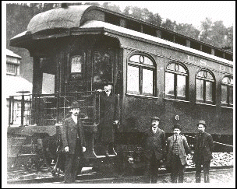
New Inventions & Innovations
George Pullman – RR Sleeping Car
George Westinghouse- Air Brakes for Trains & Alternating Current

Slide 127
New Inventions & Innovations
Thomas Edison – incandescent lightbulb, phonograph, GE, etc.
Alexander Graham Bell - telephone

Slide 128
New Inventions & Innovations
Gustavus Swift – meatpacking & refrigerated RR cars
Philip Armour – canned meats

Slide 129
New Inventions & Innovations
Henry Bessemer

Slide 130
“Robber Barons”
Andrew Carnegie - steel
Vertical Integration

Slide 131
“Robber Barons”
John D. Rockefeller – Standard Oil
Horizontal Integration

Slide 132
“Robber Barons”
Cornelius Vanderbilt – steamboats & RR consolidation
J.P. Morgan – banking & finance

Slide 133
THOMAS EDISON

Slide 134
In 1879 Edison, with the support of J.P Morgan, established a research laboratory at Menlo Park, New Jersey
From that lab, Edison would go on to receive 1,000 patent
What is a patent you ask?
It’s a government document that gives exclusive rights to produce a given product to the designer

Slide 135
CAN ANYONE TELL ME WHAT THIS IS?

Slide 136
We’re Mass Communicatin’
Trying to figure out a way to provide affordable lighting for homes, Edison invents the light bulb
Eventually he would make plans to light entire sections of a town
Edison also made waves in the music business
He patented the famous Edison cylinder that played recorded music
Finally, as if that is not enough, he makes progress in creating radios that are more powerful

Slide 137
OTHERS OF NOTE
GEORGE WESTINGHOUSE: worked with Edison on the plans to provide mass power
ALEXANDER GRAHAM BELL: well he invents the telephone, and thousands of teenagers stood up to cheer

Slide 138
Bell and Westinghouse

Slide 139
Bridges!?! We Don’t Need No Stinkin’ Bridges!
With the Bessemer process in effect, structures could do places they never had before
One place was above the city dweller’s head.
Suspension bridges connected people to places that would otherwise take hours

Slide 140
Brooklyn Bridge

Slide 141
New Technologies With Trains
Air Brakes
Refrigeration Cars: to transport foods
Telegraphs
The BIGGEST is the time zone:
Time zones were created in order to avoid mishaps that occurred on transcontinental railroads

Slide 143
What’s the impact of all this?
By the 1880’s American exports of grain, steel, and textiles dominated international markets
With thriving railroads, travel in the country was as fast as ever
The American Economy was second to none

Slide 144
THERE’S A CATCH
All of the technologies have a HUGE effect on the American culture
How did the Civil War encourage the growth of industry?
Why did industry expand even after the Civil War?

Slide 145
Mom and Pop Storeowner
Many businesses after the Civil War were family owned and operated, which meant they were limited in the amount of money they could make
Why? Because they could risk little..they had to put food on the table.
Also they were limited in the scope by geography.

Slide 146
Railroads Enter the Scene
RNRs provided new access to raw materials and markets
With this broadening of market and access, the Mom and Pop business slowly loose ground and have to adapt.
People see the possibilities of making money but still have limited resources (money, raw materials)
Eventually corporation begin to form and the single family (Mom and Pop) businesses fold

Slide 147
East Tennessee and Western North Carolina Railroad

Slide 148
CORPORATIONS
What is a Corporation, you ponder at late into the night
A corporation is a business or organization made up of people who share ownership in that organization or business.
Many corporations operated legally, but many more found ways to maximize their profits by forming a monopoly

Slide 149
Monopolies and Cartels
These corporations eventually find ways to make more money
One way was the forming of monopolies
A monopoly forms when one company acquires a majority of a single market
Another way of making the jack was to form a cartel
Cartels form when business making a product agreed to limit the production in order to keep prices high

Slide 150
Benefits and Weaknesses To Corporations
Benfits:
Make a lot of money
Limited risk for those that are involved
Greater market
Cheaper prices
More products into areas
Weaknesses:
All about the profit, not about the worker
Hurt the single family business
Distruction of the environment

Slide 151
Vanderbilt, Carnegie, Rockerfeller

Slide 152
Horizontal and Vertical Integration
Horizontal: brings many firms into the fold of a larger business
Vertical: Businessmen gain control of many businesses that are a part of a products development
All the big business dudes were doing it (Rockerfeller, Vanderbilt, Carnegie)

Slide 154
US.7
Analyze the movement of people from rural to urban areas as a result of industrialization.

Slide 155
Industrialism: A nation on the move from rural to urban

Slide 156
HORACE GREENLY
“We cannot all live in the cities, yet nearly all seem determined to do so”

Slide 157
Immigrants Come To The Cities
By 1900, some urban areas have a population that was more that 40%
Many, Many, Many Immigrants joined family members who came to America first
This was in order for them to set up somewhat before the family came

Slide 158
Typical Jobs
Steel Millers in Pennsylvania
Textile Workers in NY
Domestic Servants in Northeast
Fish Packing Industry in the Northwest
Typically Polish
European Jews
Irish Women
Scandinavians

Slide 160
How Can You Keep the Boy On the Farm After He Has Seen New York
Starting the 1890’s you seen a migration from rural/farming area into the cities
This is for better paying jobs that paid in cash- a rarity in many farming communities (everything was on credit)
Growth in cities like St. Paul-Minneapolis, Chicago, Indianapolis
To a small degree you also see African Americans moving North

Slide 162
Farm vs. City
Open spaces
Slack times for seasons
Hard to make a living
Live on credit
Confined apartments
Rigid work schedules
Opportunities out the ear
Work pays in cash

Slide 163
US.8
Evaluate multiple sources of information presented in diverse formats and media as in the political cartoons of Thomas Nast and others during the Gilded Age.

Slide 167
US.9
Describe the difference between “old” and “new” immigrants and analyze the assimilation process and consequences for the “new” immigrants and their impact on American society, including ethnic clusters, competition for jobs, rise of nativism, the work of Jane Adams, the documentation of living conditions by Jacob Riis, Chinese Exclusion Acts, and the Gentlemen’s Agreement.

Slide 168
Immigrants
Why?
Obvious dreams of wealth (land)
Education
No long period of military service
Participate in government
Escape political persecution

Slide 169
The Voyage:
Most immigrants traveled steerage: a large open area beneath the ship’s deck
No privacy
Poor accommodations
But tickets were cheap
One third traveled were: Birds of Passage: young unmarried men that would return to homeland in short time, caused some information to be inaccurate

Slide 170
The Voyage:
1865-1890 most immigrants came from: northwestern & Central European countries (Ireland, Great Britain, and Germany)
1890’s patterns change: Southern and Eastern Europe
70% of immigrants came through New York City “Golden Door”
2% went South (too few jobs)

Slide 171
The Voyage:
1892 huge reception area set up on Ellis Island in NY harbor (near Statue of Liberty)
1892 physical exam: sick or diseased would generally be deported
Immigrants generally settle in ghettoes: Chinatown, Little Italy, etc…)
Immigrants would become part of political machines to gain jobs and housing
Worked for less pay than native born

Slide 172
Ethnic Clustering

Slide 173
Immigration:
Old immigrants: mostly protestants from northern & western Europe before 1870
Some German/Irish Catholics in 1840’s-50’s
New Immigrants: starting 1870’s mostly from Southern & Eastern Europe/ many Catholic & Jewish. Most did not speak English (Italy, Poland, Hungary, & Russia)

Slide 174
Immigration & The Gilded Age
Old Immigrants
North & Western Europe
Well Educated
Protestant
Generally Wealthier
Farmers, merchants
Spread out across nation
New Immigrants
South & Eastern Europe
Little Education
Catholic, Orthodox, other religions
Poor
Factory Workers
Stayed mainly in Eastern Cities

Slide 175
Push Factors / Pull Factors
Push Factors – Events which took place in the native countries of immigrants which led them to immigrate to the United States; these include poor economy, warfare, and religious persecution.
In Mexico, Poland, and China, land reform and low prices forced many farmers off their land. Beginning in the 1840s, China and eastern Europe experienced repeated wars and political revolutions. One of the largest groups t settle in America were Russian and eastern European Jews fleeing religious persecution.
Pull Factors – Perceived opportunities in the United States that led people in other countries to immigrate to the United States; these include cheap land in the American west and industrial jobs in American cities, political stability, and freedom of religion.
The United States offered special attractions, including plentiful land and employment. The 1862 Homestead Act and aid from railroad companies made western farmland inexpensive. The railroads even offered reduced fares to get there because they needed customers in the west for their own business to succeed. Until 1885, immigrants were recruited from their homelands to build railroads, dig mines, work in oil fields, harvest produce, or toil in factories. Others hoped to strike it rich by finding gold.

Slide 176
Immigration & The Gilded Age
Push Factors
Crop Failures (Potato Famine)
Political Tyranny
Religious Oppression
Persecution
Economic hardship
Lack of jobs
War
Pull Factors
Plenty of Available Land
Democracy
Religious & Political freedom
Factory jobs
Family in the USA

Slide 177
The immigrant experience
The decision to leave
Travel steerage: lower decks, no privacy, crowded dirty, disease. Cheapest but worst
Arrive go through processing station
Examples: Ellis Island: NY 1892, must pass medical examination “NY Golden Door”

Slide 178
Ellis Island / Angel Island
Ellis Island – Immigrant processing station in New York Harbor for most immigrants entering the United States from Europe, Africa, and the Caribbean between 1892 and the 1960s.
In the processing station immigration officials decided who could stay in the United States. To enter, immigrants had to be healthy and show that they had money, a skill, or a sponsor to provide for them. While 1st and 2nd class passengers were inspected on the ship and released unless they had obvious medical problems, all 3rd and steerage class passengers had to go through Ellis Island. There immigration officers conducted legal and medical examinations. Only about 2% of immigrants were denied entry.
Angel Island – Immigrant processing station in San Francisco Bay for most immigrants entering the United States from Asia and the Pacific Islands between 1910 and the 1960s.
While Ellis Island was generally welcoming, the purpose of Angel Island was to filter out unwanted immigrants, specially the Chinese. After 1882, Chinese immigrants were turned away unless they could prove that they were American citizens or had relatives living in America. Officials often assumed that Chinese newcomers would misrepresent themselves in order to gain entry. While most immigrants left Ellis Island within hours, Chinese immigrants at Angel Island often spent weeks or even months detained in poor conditions.
Closure Question #2: What problems did immigrants face in coming to America?

Slide 179
On the West Coast
Most immigrants from Asia (China and Japan)
Many Native Americans racist toward Asian people
At one point Chinese prohibited from entering Colorado
Schools Segregated

Slide 180
Chinese Immigrants
At the same time, Chinese immigrants are face equal prejudice on the west coast
California barred cities from employing people of Chinese ancestry in 1879
Several years later San Francisco established a segregated school
Other places mobs form complaining that Chinese had taken “white” jobs

Slide 181
Chinese Exclusion Act

Slide 182
Saum Song Bo
“That statue represents Liberty holding a torch which lights the passage of those of ALL nations who come into this country”
“But are we Chinese allowed to come? As for the Chinese who are here, are they allowed to enjoy liberty as men of all other nationalities enjoy it?”

Slide 183
Yick Wo v. Hopkins
Besides the magazines Saum Song Bo used, Chinese immigrants turned to the U.S court system
In 1886 the case of Yick Wo v. Hopkins, the Supreme court sided with Chinese immigrants who challenged the California law that banned Wo from operating a laundry
In 1898 the Court rules that Chinese could not be stripped of the citizenship

Slide 185
Americanization / Melting Pot
Americanization – A process through which an immigrant and his/her descendants abandon their native customs and language, replacing them with English and American dress, diet, and traditions.
Most new immigrants stayed in cities, close to industrial jobs and factories. There, they often lived in ethnic neighborhoods, called ghettoes, with people who shared their native language, religion, and culture. By 1890, many cities had huge immigrant populations. In San Francisco and Chicago, they made up more than 40% of the population. 4 out of 5 inhabitants of New York City were foreign born or had foreign-born parents.
In many cities, volunteer institutions, known as settlement houses, ran Americanization programs. At the same time, immigrants helped one another through fraternal organizations, such as the Polish National Alliance and the Ancient Order of Hibernians. These organizations, based on ethnic or religious identity, provided social services and financial assistance.
Melting Pot – A society in which white people of all different nationalities blend to create a single culture; the United States at the turn of the 20th century was considered to be a melting pot society.

Slide 186
Nativism

Slide 187
Nativism
Political movement known as Nativism strengthened in late 1800’s
Nativism: favoring native born Americans over immigrants
One reason political success of immigrants
Second: Catholic Faith
Promote:
English only schools
American Culture
Members of the American Protective Association vote for and hire protestants only

Slide 188
Nativism:
belief that native born Americans were superior to immigrants
WASP:
White, Anglo-Saxon, Protestant

Slide 190
Gentlemen’s Agreement

Slide 191
The Gentlemen's Agreement of 1907
was an informal agreement between the United States and the Empire of Japan whereby the United States of America would not impose restriction on Japanese immigration, and Japan would not allow further emigration to the U.S. The goal was to reduce tensions between the two powerful Pacific nations. The agreement was never ratified by Congress, and was ended by the Immigration Act of 1924.

Slide 192
The Gentlemen's Agreement of 1907
The immediate cause of the Agreement was anti-Japanese nativism in California. In 1906, the San Francisco, California Board of Education passed a regulation whereby children of Japanese descent would be required to attend separate, racially specific schools. At the time, Japanese immigrants made up approximately 1% of the population of California; many of them had immigrated after the treaty between the two countries in 1894 that opened Japan up to trade with the US and had assured free immigration from Japan.
In the Agreement, Japan agreed not to issue passports for Japanese citizens wishing to work in the continental United States, thus effectively eliminating new Japanese immigration to America. In exchange, the United States agreed to accept the presence of Japanese immigrants already residing in America, and to permit the immigration of wives, children and parents, and to avoid legal discrimination against Japanese American children in California schools.
Japan did not want America to pass any legislation confronting the Japanese immigrants, in response to what happened to Chinese under the Chinese Exclusion Act. President Theodore Roosevelt, who had a positive opinion of Japan, accepted the Agreement as proposed by Japan as an alternative to more formal, restrictive immigration legislation.

Slide 193
Competition for Jobs

Slide 194
Urbanization
A process through which the number of cities and people living in cities within a country increases; in the late 19th century, America experienced a dramatic increase in Urbanization partly due to the influx of new immigrants and rural-to-urban migration.
America’s major cities were manufacturing and transportation centers clustered in the Northeast, on the Pacific Coast, and along the waterways of the Midwest. Connected by railroad lines, cities became magnets for immigrants and rural Americans. They were attracted by jobs in factories or the service industries.
Women’s opportunities were dramatically expanded in urban areas. In addition to factory work, they could take in boarders, do piecework, or become domestic servants. Educated women found work as teachers or in offices as secretaries and typists.
While city jobs required hard work for little pay, city life offered variety, promise and a bit of glamour to residents. By saving part of their wages, city workers might attain some comforts or perhaps even move into the growing middle class, and at the very least they could improve their children’s opportunities by sending them to school.
City churches, theatres, social clubs and museums offered companionship and entertainment.
Closure Question #1: Why did immigrants and rural migrants move to cities?

Slide 195
Rural-to-Urban Migrants
Americans who moved from farms and agricultural work, often in the Southern states, to cities in the Northeast and Midwest.
The move from farm to factory was difficult. Former agricultural workers often found themselves working in dim light and narrow confines. The pace of work was controlled by rigid schedules, with no slow seasons. However, factory work paid wages in cash, which was sometimes scarce on family farms. The increasing difficulty of making a living on a farm combined with the excitement and variety of city life sparked migration.
Midwestern cities such as Minneapolis-St. Paul and Chicago exploded between 1880 and 1890. Many newcomers to these cities were migrants from the rural West. They were attracted by land but also by economic opportunities. African Americans moving out of the South were also part of the migration, though on a smaller scale.
By 1900, some urban areas had a population that was more than 40% foreign born. Many immigrants joined family members in the cities while others were recruited by companies needing labor. Neighborhoods, cities, regions and industries often acquired a majority of workers from a particular locale. For example, employees at the steel mills in western Pennsylvania were predominantly Polish, while the textile factories of New York became a center for eastern European Jewish people. Domestic servants in the Northeast were primarily Irish women, while Scandinavians worked in the fish-packing industry of the Pacific Northwest.
Closure Question #1: Why did immigrants and rural migrants move to cities?

Slide 196
Skyscrapers / Elisha Otis
Skyscrapers – Ten-story and taller buildings with steel frames and artistic designs used for office space in major American cities.
Elisha Otis – Inventor of the safety elevator in the 1850s, making the use of skyscrapers for office use more practical.
Centralized heating systems were also improved in the 1870s, further enhancing the practicality of establishing offices in skyscrapers.
During the late 1800s, architecture emerged as a specialized career. The American Institute of Architecture was established in 1857 to professionalize the practice. Its members encouraged specific education and official licensing in order to become an architect.
These professionals designed the buildings that were quickly becoming hallmarks of urban life: public schools, libraries, train stations, financial institutions, office buildings, and residences.
As cities swelled in size, politicians and workers struggled to keep up with the demands of growth to provide water, sewers, schools, and safety. American innovators stepped up to the task by developing new technologies to improve living conditions. The middle and upper classes benefited most from the innovations, but every city dweller was affected. Electric trolleys and subways, building codes, and other innovations kept crowded cities from slipping into pollution and chaos.
Closure Question #2: How did city planners try to improve city life?

Slide 197
Mass Transit / Suburbs
Mass Transit – Public systems that could carry large numbers of people fairly inexpensively; these include rail lines, trolleys, electric cable cars, subways, and busses.
In 1888, Richmond, Virginia introduced the first streetcar system powered by electric cables. Within a decade every major city followed. Commuter rail lines had carried people to areas in and around cities since the 1870s; However, they were powered by coal-driven steam engines, making them slow, unreliable, and dirty.
Some cities used trolleys pulled by horses, which were slower and left horse waste all over the streets. Electricity, on the other hand, was quiet, clean, and efficient. Electric cars ran on a reliable schedule and could carry many more people than horse-drawn carts.
Suburbs –Communities established on the perimeter of industrial cities; Middle and upper class people began moving to the suburbs in the late 1800s as a result of the development of mass transit, which permitted them to commute to work in the city.
Closure Question #2: How did city planners try to improve city life?

Slide 198
Frederick Law Olmstead
Landscape engineer who pioneered the idea of establishing city parks in urban centers; Olmstead designed New York’s Central Park, Philadelphia’s Fairmount Park, and several others across the country.
As cities grew larger and more complex, architectural firms expanded to offer city-planning services designed to make cities more functional and beautiful, even as their populations skyrocketed. Architect Daniel Burnham designed his version of the ideal city for Chicago’s 1893 World’s Columbian Exhibition, a fair held to commemorate Columbus’ arrival in the Americas. Called the White city, the integrated design included boulevards, parks, buildings and even electric streetlights.
Mass transit allowed city planners to segregate parts of the city by zoning, or designating certain areas for particular functions. Through the 1890s, cities embraced designs that had separate zones for heavy industry, financial institutions, and residences. They also built public spaces, such as public libraries, government buildings, and universities.
Parks and recreational spaces were one of the most important aspects of city planning. Since the 1850s, cities had built parks as a solution to some of the problems of urban growth. Philadelphia purchased areas along the Schuylkill River to protect the city’s water supply from industrial pollution.
Closure Question #2: How did city planners try to improve city life?

Slide 199
URBAN PROBLEMS
Problems in American cities in the late 19th and early 20th century included:
Housing: overcrowded tenements were unsanitary
Sanitation: garbage was often not collected, polluted air
Famous photographer Jacob Riis captured the struggle of living in crowded tenements

Slide 200
URBAN PROBLEMS CONTINUED
Transportation: Cities struggled to provide adequate transit systems
Water: Without safe drinking water cholera and typhoid fever was common
Crime: As populations increased thieves flourished
Fire: Limited water supply and wooden structures combined with the use of candles led to many major urban fires – Chicago 1871 and San Francisco 1906 were two major fires
Harper’s Weekly image of Chicagoans fleeing the fire over the Randolph Street bridge in 1871

Slide 201
Jacob Riis – How the Other Half Lives

Slide 202
PHOTOGRAPHER JACOB RIIS CAPTURED IMAGES OF THE CITY

Slide 203
Jacob Riis

Slide 204
Jacob Riis

Slide 205
Jacob Riis

Slide 206
Jacob Riis

Slide 207
Jacob Riis

Slide 208
Jacob Riis

Slide 209
REFORMERS MOBILIZE
Jacob Riis was a reformer who through his pictures hoped for change– he influenced many
The Social Gospel Movement preached salvation through service to the poor
Some reformers established Settlement Homes
These homes provided a place to stay, classes, health care and other social services
Jane Addams was the most famous member of the Settlement Movement (founded Hull House in Chicago)
Jane Addams and Hull House

Slide 210
The Settlement House Movement
One approach to the poverty experienced in the American City was the Settlement House movement
A settlement House is a community center that provided social services to urban poor such as a roof over their head, and meals in the stomach, child care classes were given to mothers and English classes

Slide 211
Jane Addams To The Rescue
After graduating from Rockford Female Seminary, Addams travelled to London in 1888
There she was inspired by the Toynbee Hall Settlement house
Upon her return, she opened the Hull House settlement house in Chicago in 1889

Slide 212
The Hull House

Slide 213
The success of the house inspired many college educated, well meaning, middle class women to become social workers
By 1911 the country would have four hundred such houses

Slide 214
Jane Addams – Hull House

Slide 215
Tenements
Low-cost multifamily housing designed to squeeze in as many families as possible; with few windows and little sanitation, tenements were unhealthy and dangerous.
Growing cities faced many problems caused by overcrowding and poverty. In 1890, New York’s Lower East Side had a population of more than 700 people per acre. As immigrants and rural migrants arrived, they crowded into neighborhoods that already seemed to be overflowing.
As newcomers moved into urban areas, those who could not afford to ride mass transit had to live within walking distance of the industrial plants and factories where they worked. Housing in densely populated neighborhoods was often aging and usually overcrowded. Sometimes, several families lived in one apartment or even one room. They used the space for sewing clothes or doing other piecework to earn money.
Tenement owners usually lived in the suburbs or in fashionable downtown areas, away from the industrial grime. However, they built apartments for desperate people who had little choice about where they lived. In 1890, journalist Jacob Riis drew attention to the plight of New York tenement dwellers. “Go into any of the ‘respectable’ tenement neighborhoods… you shall come away agreeing (that)… life there does not seem worth living… The airshaft seems always so busy letting out foul stenches that it has no time to earn its name by bringing down fresh air…” –Jacob Riis
Closure Question #3: Why did the cities of the late nineteenth century have many problems?

Slide 216
Tenements

