Slide 1
The Roaring Twenties
Jaclyn Cleveland
Sweetwater High School
Sweetwater, TN

Slide 2
America in the 20th century: The Roaring Twenties
http://app.discoveryeducation.com/player/view/assetGuid/FB3F882C-B47C-45FB-9044-D60576F1D56C
30 minutes

Slide 3
Daily Openers
What would you do today if:
You were diagnosed with Type 1 Diabetes?
You wanted a slice of bread?
You had a minor cut on your hand?
http://www.history.com/topics/roaring-twenties/videos/1920s-inventions

Slide 4
Daily Opener
What is your favorite time period/topic in history?

Slide 5
When You are finished:
Quizlet
Edit – Check for errors
Email the link or share to:
Price_Jaclyn@Hotmail.com
Junior Scholastic
Be sure to read the chocolate article.
Read other articles of interest.
Be able to discuss.
Place magazines on teacher desk.

Slide 6
Objective:
Recognize the new trends, ideas, and innovations of the 1920's popular culture
Automobile
Radio
Flapper
Birth Control
Prohibition
Organized Crime
Sports

Slide 7
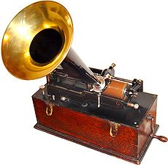
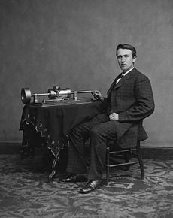
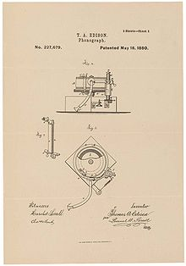
Phonograph
Thomas Edison and his early phonograph.

Slide 8
Phonograph
most common device for playing sound recordings in the 1870s

Slide 9
Presidents of the 1920s
Wilson 1913-1921
Harding 1921-1923
Coolidge 1923-1929
Hoover 1929-1933

Slide 10
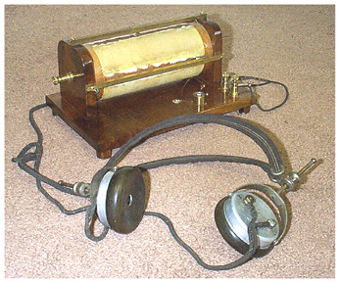
Radio

Slide 11
Mass Media
Increases in Mass media during the 1920s
Print and broadcast methods of communication.
Examples:
Newspapers
Magazines
Radio
Movies

Slide 12
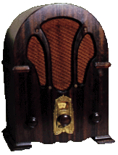
RADIO
Most powerful communications medium to emerge in the 1920s
News was delivered faster and to a larger audience.
Americans could hear the voice of the president or listen to the World Series live.

Slide 13
Newspapers:
27 million to 39 million
Increase of 42%
Motion Pictures:
40 million to 80 million
Increase of 100%
Radios:
60,000 to 10.2 million
Increase of 16,983%

Slide 14
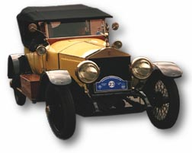
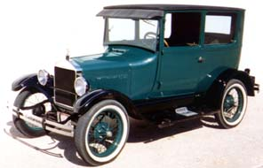
Automobile

Slide 15
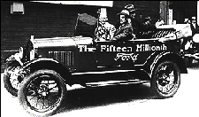
Automobile
Henry T. Ford
Improved transportation
Gave economy boost it needed
By 1927, Model-T had really taken off.

Slide 16
http://www.biography.com/people/henry-ford-9298747/videos/henry-ford-a-car-for-the-people-2087064480 - short
Bio - http://www.biography.com/people/henry-ford-9298747
Long episode - http://www.biography.com/people/henry-ford-9298747/videos/henry-ford-full-episode-2073247507

Slide 17
Flapper
Short hair
Short skirts
Smoking/ drinking
Shift away from traditional values took place mainly in the cities

Slide 18
Women
Women were independent and achieving greater freedoms.
Examples: right to vote, more employment, freedom of the auto

Slide 19
The Changing American Family
American birthrates declined for several decades before the 1920s.
Trend continues in 1920s with development of birth control.
Margaret Sanger
Birth control activist
http://www.biography.com/people/margaret-sanger-9471186
Margaret Sanger and other founders of the American Birth Control League - 1921

Slide 20
1920s – more people living in urban than rural settings, first time

Slide 21
Migration from Rural to Urban
Urbanization still accelerating
More Americans lived in cities than in rural areas
1920:
New York 5 million
Chicago 3 million

Slide 23
URBAN VS. RURAL
Farms started to struggle post-WWI.
6 million moved to urban areas
Urban life – a world of anonymous crowds, strangers, moneymakers, and pleasure seekers.
Rural life - safe, with close personal ties, hard work and morals.
Suburban boom: trolleys, street cars etc.

Slide 24
Farms were innocent.
Cities were impersonal.

Slide 25
Prohibition

Slide 26
Prohibition
18th Amendment, 1920
Launched era known as Prohibition
Made it illegal to make, distribute, sell, transport or consume liquor.
Prohibition led to...

Slide 27
https://www.youtube.com/watch?v=FTIA84IrEvc
First 1.30
Where are they?

Slide 29
SPEAKEASIES AND BOOTLEGGERS
Most immigrant groups were not willing to give up drinking.
Hidden saloons-speakeasies
People also bought liquor from bootleggers who smuggled it in from Canada, Cuba and the West Indies
Speakeasies

Slide 30
Organized Crime

Slide 31
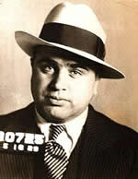
Al Capone
From an Italian immigrant family
Also known as "Scarface," rose to infamy as the leader of the Chicago mafia during the Prohibition era.

Slide 32
Prohibition contributed to the growth of organized crime in every major city
Al Capone –
Took over Chicago mob in 1925
Ran brothels
Famous bootlegger
60 million a yr (bootleg alone)

Slide 33
Al Capone was known to kill his enemies but later he also encouraged peace among rival gangsters.
Most famous murder - St. Valentine's Day Massacre
https://www.youtube.com/watch?v=VzfWQ7TRF8w
Mini bio

Slide 34
Talent for avoiding jail
1931 sent to Alcatraz prison for tax-evasion. Capone’s death - http://www.history.com/topics/roaring-twenties/videos/al-capone?m=528e394da93ae&s=undefined&f=1&free=false

Slide 35
Lost Generation
the generation reaching maturity during and just after World War I, a high proportion of whose men were killed during those years.
an unfulfilled generation coming to maturity during a period of instability

Slide 36
Take 3 Quizlet Quizzes under US History tab on the www.clevelandhistory.com website
Meet with your group – discuss details, topic, members, etc.

Slide 37
US.40 Describe the Harlem Renaissance, its impact, and its important figures, including an
examination of literary and informational text of or about:

Slide 38
Harlem Renaissance
Spanning the 1920s to the mid-1930s, the Harlem Renaissance was a literary, artistic, and intellectual movement that kindled a new black cultural identity as a black art form.

Slide 39
Its essence was summed up by critic and teacher Alain Locke in 1926 when he declared that through art, “Negro life is seizing its first chances for group expression and self determination.”
Harlem became the center of a “spiritual coming of age” in which Locke’s “New Negro” transformed “social disillusionment to race pride.”
Clip - http://www.history.com/topics/black-history/harlem-renaissance

Slide 40
The 1920s Review Quiz
What was the Harlem Renaissance?
Name one person involved with the Renaissance.
Use ten key words that would describe the 1920s(For example – flappers, now think of 9 more)
What was the new mass media of the 1920s?

Slide 41
Daily Opener – Briefly describe the Harlem Renaissance.
https://www.youtube.com/watch?v=YBOoQcoPL1I
The best of Louis Armstrong
US.40 Describe the Harlem Renaissance, its impact, and its important figures, including an examination of literary and informational text of or about Langston Hughes, Zora Neale Hurston, James Weldon Johnson, Duke Ellington, and Louis Armstrong. (C)
Work in groups to evaluate the importance of your assigned Harlem
Renaissance figure and create a visual presentation.

Slide 42
Harlem Renaissance
Period during the 1920s in which African American novelists, poets, and artists celebrated their culture.

Slide 43
After WWI, most African American migrants to the north probably found a better life.
Wages were better
There was a growing middle and upper class
African American ministers, physicians, lawyers, and doctors practiced their profession and served as role models to the younger generation.

Slide 44
Jazz
It was F. Scott Fitzgerald who called the 1920s the “Jazz Age” but it was African Americans who gave the age its jazz.
Jazz musicians creatively recombine different forms of music, including African American blues and ragtime, and European-based popular music.
Jazz emerged in the South and Midwest, particularly in New Orleans.

Slide 45
Jazz
From the south, jazz spread north with the Great Migration of African Americans.
Louis Armstrong’s ability to play the trumpet and his subtle sense of improvisation made him a legend and influenced the development of jazz.
Many Jazz artists featured vocalists like Bessie Smith, the “Empress of the Blues”.

Slide 46
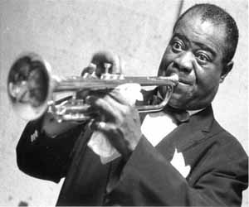
Louis Armstrong
http://www.biography.com/people/louis-armstrong-9188912 OR
https://www.youtube.com/watch?v=sIILBeUrYLk\
Trumpet player
“What a Wonderful World”
https://www.youtube.com/watch?v=E2VCwBzGdPM
“Star Dust”

Slide 47
Duke Ellington
Became one of the most important early figures in jazz and probably its greatest composer.
Gained fame in 1920s when his band played in Harlem nightclubs.
Hiring many skilled musicians
Wrote or arranged around 2,000 pieces of music that range from popular songs to ballets and movie music
http://www.biography.com/people/duke-ellington-9286338

Slide 48
What exactly was Jazz?
Symbol of the 1920s
Played in speakeasies
Sound of the Cotton Club, one of Harlem’s most famous attractions
Demonstration of the depth and richness of African American culture

Slide 49
James Weldon Johnson
An early civil rights activist
Leader of the NAACP
A leader in the founding and creation of the Harlem Renaissance

Slide 50
Langston Hughes
http://www.biography.com/people/langston-hughes-9346313/videos/langston-hughes-mini-biography-2174109638
leading voice of the Harlem Renaissance
whose poetry showcased the dignity and beauty in ordinary black life
The hours he spent in Harlem clubs affected his work, making him one of the innovators of Jazz Poetry.
Read primary sources found on page 359 in your book.

Slide 51
Zora Neal Hurston
http://www.biography.com/people/zora-neale-hurston-9347659
Fixture in the Harlem Renaissance
Most famous piece – Their Eyes Were Watching Gods – expressed the new longing for independence felt by many women, black and white.

Slide 52
In your Notebook, answer the question:
Write a thesis statement and introductory paragraph for an essay in which you compare the influence of jazz to the influence of the Harlem Renaissance. Consider the similarities and differences in the two cultural developments.
Read Section 5 in Chapter 11 and look at your notes for help.

Slide 53
US.40 Describe the Harlem Renaissance, its impact, and its important figures, including an examination of literary and informational text of or about Langston Hughes, Zora Neale Hurston, James Weldon Johnson, Duke Ellington, and Louis Armstrong. ©
EXTRAS:
https://www.youtube.com/watch?v=Z3ozfYC9CZE
10 minutes – 3 clips on Renaissance from PBS

Slide 54
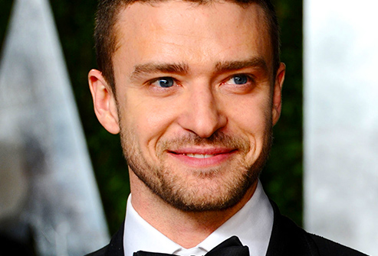
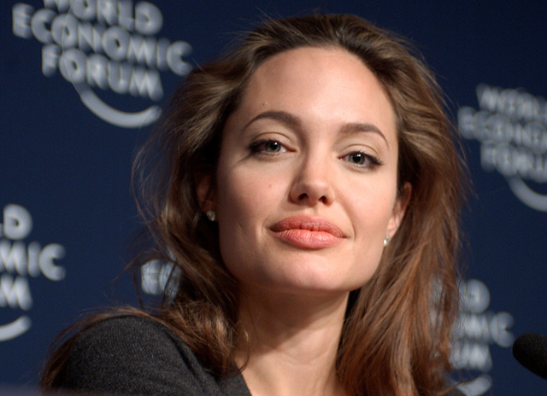
How do celebrities affect popular culture? How do they affect students at SHS?

Slide 55
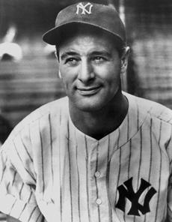
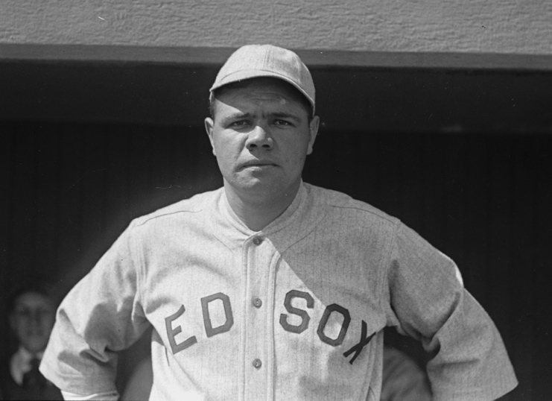
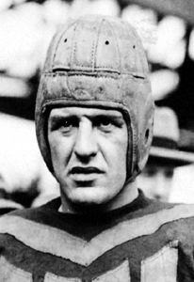
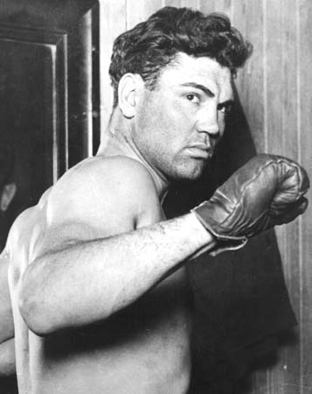
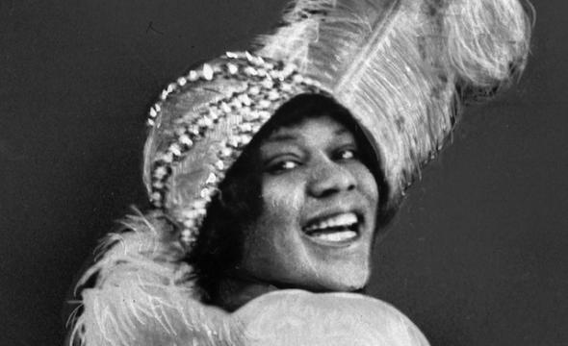
1920s Celebrities
US.43 Analyze the rise of celebrities as icons of popular culture, including Babe Ruth, Lou Gehrig, Jack Dempsey, Red Grange, Bessie Smith, Billy Sunday, and Charles Lindbergh.

Slide 56
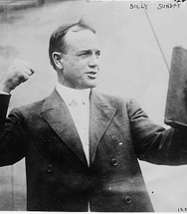
Billy Sunday
From famous baseball player (Chicago White Stockings, set a record for most stolen bases) to famous evangelist
Known for his evangelist campaigns across America
Railed against sin, vice, and alcohol, his theatrical style gained him large crowds and newspaper coverage
The leaders of big cities like NYC and Chicago welcomed Billy Sunday’s message as an aid in their attempt to combat crime
Estimated that 100 million people heard him preach and 1 million people were saved

Slide 57
Charles Lindbergh
“Lucky Lindy”
In May 1927, he took off from Long Island, New York in a tiny, single engine plane
First to fly across the Atlantic solo and non-stop
He landed in Paris 33 hours later
The radio reported it &
Movie newsreels showed his triumphant return home
Instant celebrity
https://www.youtube.com/watch?v=nTwiu6wnpqw

Slide 58
Bessie Smith
Born in Chattanooga, TN 1894
“Empress of the Blues”
Known for her strong, soulful voice
Hit Downhearted Blues
Elaborate shows

Slide 59
1920s – The Golden Age of Sports
Before the 1920s, most sports heroes were local athletes.
Thanks to increased newspaper readership and the rise of radio coverage, every major sport boasted nationally famous performers.
Babe Ruth
Lou Gehrig
Jack Dempsey
Red Grange

Slide 60
Red Grange
American football player best known for his frequent touchdowns
Got the nickname “galloping ghost” after running 5 touchdowns in a single game
University of Illinois
Charter member of both the college and pro football hall of fame
ESPN named him the ‘greatest football player of all time’
Later became a sportscaster

Slide 61
Jack Dempsey
Known as the “Manassa Mauler”
Born in Manassa, Colorado
Was the world heavy weight boxing champion from 1919-1926
Loved boxing, mining, and the cowboy life
Older brother taught him how to box

Slide 62
Babe Ruth
“Bambino”
“Sultan of Swat”
Originally a standout pitcher for the Boston Red Sox
Ruth gained fame as a slugging outfielder for the New York Yankees
Record for most home runs in a season stood for more than 30 years and his record for most home runs in a career lasted even longer
Helped popularize baseball again after a gambling scandal
What is the curse of the Bambino?
https://www.youtube.com/watch?v=bMbLaMBKNqI

Slide 63
Lou Gehrig
Born in 1903
The only one of four children to survive infancy, Lou was brought up in extreme poverty.
Star athlete for the New York Yankees
Set the mark for consecutive games played 2,130
Nicknamed The Iron Horse

Slide 64
Just The Facts: The Emergence of Modern America
http://app.discoveryeducation.com/player/view/assetGuid/DF730D9E-F30A-4918-8276-FBA506869AB7
30 minutes
Handouts
https://gtm-media.discoveryeducation.com/videos/12220/53361.pdf

Slide 65
Babe Ruth & Gehrig were an awesome duo on the lineup for the Yankees.
Gehrig was a stellar athlete until ALS started to set it.
http://www.lougehrig.com/about/farewell.html
Died of ALS in 1941

Slide 66
Questions
How did the new mass media of the 1920s contribute to Charles Lindbergh’s rise to fame?
How did movies and the radio cut across geographic barriers?
How did the new mass culture reflect technological and social changes?
4. How did the new mass media contribute to the rise of celebrities?
5.

Slide 67
US.41 Analyze the emergence of the “Lost Generation” in American literature, including the impact of Ernest Hemingway & F. Scott Fitzgerald.

Slide 68
Lost Generation
Chart on page 350
Get notes for F. Scott Fitzgerald and Ernest Hemingway

Slide 69
Describe the significant ideas and events of the administration of Warren Harding and Calvin Coolidge, including the ‘return to normalcy,’ Teapot Dome, and laissez faire policies.

Slide 70
Article Questions: Answer the following questions by reading the article.
Between 1800 and 1920 the number of children borne by the average American woman fell from ____ to _____.
How did the work week change from 1900 to 1929?
According to one prominent ad-man, what do people buy things for?
In 1920, for the first time, more people lived in_________ than in _______.
In the mid 1920s, what were the most common sources of disagreement between teenagers and their parents?
By the mid 1920s, almost 2/3rds of Americans had electricity. What did they buy b/c of this?
7. What was the new mass media of the 1920s?
8. Describe Warren Harding’s personality in one sentence.
9. Describe Calvin Coolidge’s personality in one sentence.
10. Describe Herbert Hoover’s personality in one sentence.
11. Who was John Scopes?
12. Briefly describe the new Ku Klux Klan.
13.The twenties were arguable the nation’s first _____________ decade.
14. Write down 6 terms you did not know and look up the definition.

Slide 71
Warren Harding
Rejected Woodrow Wilson’s League of Nations and progressivism
Harding wanted to end foreign crusades
Harding called for “A return to normalcy”
He wanted to go back to ‘simpler’ times before Wilson’s terms
The election of 1920 was the 1st Presidential election in which women were allowed to vote under the 19th amendment.
American voters overwhelmingly elected Harding, who promised a return to simpler days.

Slide 72
Warren Harding

Slide 73
Warren Harding
By the 1920s, the United States was an economic giant.
It was the richest, most industrialized country in the world
The US was now the largest creditor nation in the world.
Creditor Nation – other countries owed the US more money than the US owed them.

Slide 74
Warren Harding
Favored lower taxes on individuals and corporations
Liked laissez faire policies better
Raised protective tariffs
Very likable to talk to
Not the most intelligent President
“I talk to one side and they seem right. I talk to the other side and they seem just as right, and here I am where I started.”

Slide 75
Harding
Often relied on others to make decisions for him
Many were his close friends who were greedy and small minded. Nicknamed the “Ohio Gang”

Slide 76
Warren Harding
1921-1923
http://www.biography.com/people/warren-g-harding-9328336

Slide 77
The 1920s was a booming time economically speaking in America.
Henry Ford introduced a series of methods and ideas that revolutionized production, wages, working conditions, and daily life.
mass production, assembly lines, scientific management
The boom in the auto industry stimulated booms in other industries such as rubber, glass, asphalt, wood, insurance, road construction and more.

Slide 78
Harding – Teapot Dome Scandal
Worst scandal
Involved Albert Fall, Secretary of the Interior
Fall arranged to transfer oil reserves in Elk Hills, California and Teapot Dome, Wyoming , from the Navy to the Interior Department.
The oil reserves were in place for the Navy’s use in case of an emergency .
Once Albert Fall had control, he started to lease out the oil reserves to private oilmen in return for ‘loans’ (bribes.)
The Senate began to investigate and this was revealed by 1924, but Harding had already died of a heart attack in 1923.

Slide 79
Teapot Dome Scandal
Answer Questions 1 & 2 on page 331

Slide 80
Calvin Coolidge

Slide 81
Calvin Coolidge
1923-1929
Silent Cal
Quiet, honest, frugal - a man who measured his words carefully
Put his trust in business and put his administration in the hands of men who held to the simple virtues of an older America

Slide 82
Calvin Coolidge
“The chief business of the American people is business. They are profoundly concerned with producing, buying, selling, investing, and prospering in the world… We make no concealment of the fact that we want wealth, but there are many other things that we want very much more. We want peace and honor, and that charity which is so strong an element of all civilization. The chief ideal of the American people is idealism.”

Slide 83
Calvin Coolidge
Worked towards
Reducing the national debt
Trimming the federal budget
Lowering taxes to give incentives for businesses
Coolidge thus saw a spectacular boom in the American economy. For almost 6 years, the economy boomed.
Like Harding, he mistrusted the use of legislation to achieve social change.
Answer Page 334
Answer questions 3-5

Slide 84
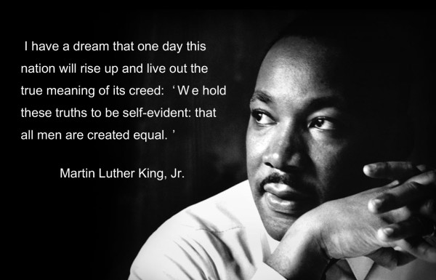
Daily opener
What is considered the oldest terrorist group in the United States by most people?
How would a group qualify as a terrorist group?

Slide 85
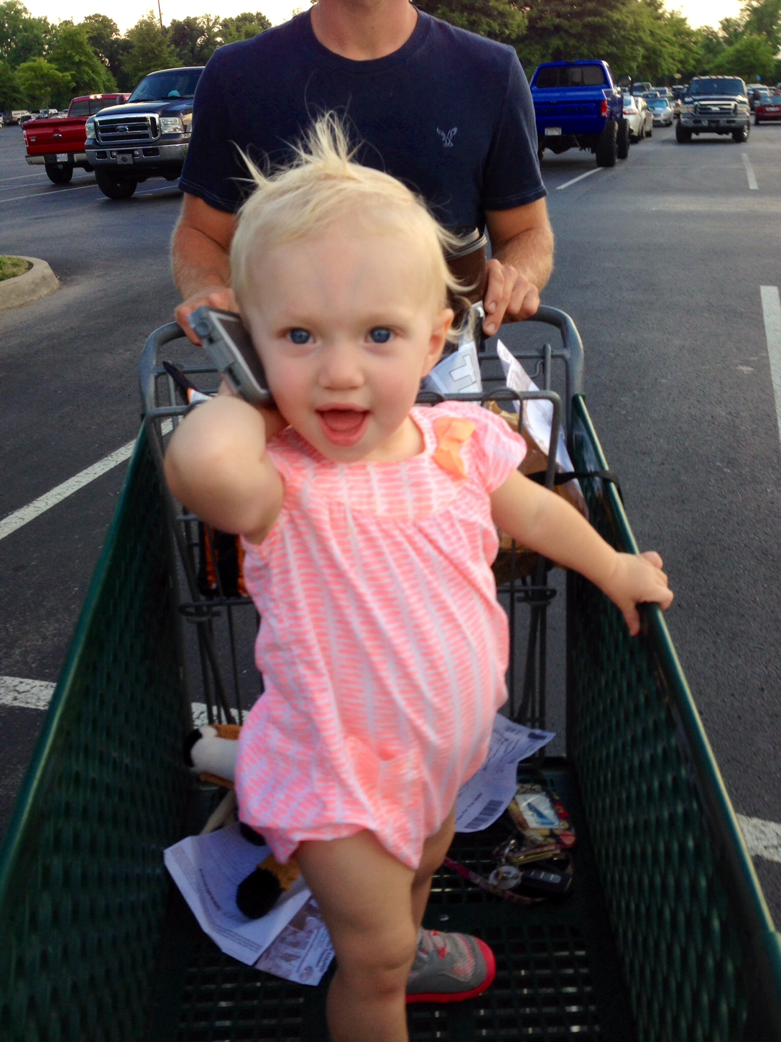
Daily Openers & Reminders
Is there an immigration problem in the United States today?
What do you think should be done about this.
Unless you are this cute, keep your cell phones completely out of sight.

Slide 86
Reading Activity
Read page 39-42 and answer
When you read the saga of how the Great Smoky Mountains came about, what surprises you?
2. How do you think the Scopes Trial and the coverage of it affected the way people saw Tennesseans?

Slide 87
US.36 Analyze the attacks on civil liberties and racial and ethnic tensions, including the Palmer
Raids, the immigration quota acts of the 1920’s, the resurgence of the Ku Klux Klan, the efforts
of Ida B. Wells and Randolph Miller, the trial of Sacco and Vanzetti, the emergence of
Garveyism, and the rise of the NAACP. (C, H, P, TN)

Slide 88
http://app.discoveryeducation.com/player/view/assetGuid/1DDDA06E-9C8F-486E-843E-85DB52BDCD7B
United streaming clip – 2minutes
Title -
Read Handout
Between the Wars: The Palmer Raids
http://chnm.gmu.edu/courses/hist409/red.html
http://www.humanities.uci.edu/history/ucihp/resources/11th%20grade%20for%20website/11.4%2011.5%20HOT%20Red_Scare.pdf
Thorough packet on Palmer Raids

Slide 89
Immigration Quota
Two important laws:
Emergency Quota Act of 1921 and
National Origins Act of 1924
Set up a simple formula: the number of immigrants of a given nationality each year could not exceed 2 percent of the number of people of that nationality living in the United States in 1890.
For example, the act permitted about 65,721 immigrants from England and Northern Ireland to come to America every year, but it allowed only about 5,802 immigrants from Italy.
Established a quota system to govern immigration from specific countries.
Excluded most Asian immigrants

Slide 90
Resurgence of the KKK
In 1915, the second KKK started in Atlanta, Georgia,
By 1921, the KKK started using a modern business system.
Reflecting the social tensions of urban industrialization and an accelerated immigration rate, its membership grew more rapidly in cities.
The KKK opposed labor unions ( since many of the labor union members were immigrants).
This KKK preached anti-Catholicism and nativism.

Slide 91
Resurgence of the KKK
A white Protestant fraternity
At its height in the 1920s, the “Invisible Empire” boasted to have 15% of the eligible population (roughly 4 million members)
Federal and state structures
The group carried out violent acts (mainly in South)
One example of a KKK stronghold was Indiana where David Stephenson ruled with an iron fist. (remember his name when you watch the KKK documentary)

Slide 92
Resurgence of the KKK
The KKK thrived on terrorizing civilians at night.
Burned crosses in their yard
Wore masks
Followed leaders with titles such as Grand Dragon and Imperial Wizard

Slide 93
Resurgence of the KKK
“To make a case against a birthplace, a religion, or a race is wickedly un-American and cowardly. The whole trouble with the Ku Klux Klan is that it is based on such foolishness that it is bound to be a menace to good government in any community.” – William Allen White, letter to the editor of the New York World 1921

Slide 94
Resurgence of the KKK
The Klan became thoroughly corrupt.
Stephenson was put in jail on assault and second degree murder charges.
By the late 1920s, the Klan stood exposed.
Although it never disappeared, it withered in importance.

Slide 95
How did the goals of the new Ku Klux Klan differ from those of the old Klan?

Slide 96
Why did people join the KKK?

Slide 97
Why did people join the KKK?
Patriotism
Others felt it was a link to the post Civil War South
Many felt threatened by the Bolshevik revolution in Russia and by the large number of immigrants
Many had the goal to stop the changing ethnic character of American society

Slide 98
Resurgence of the KKK
Add to your notes on the KKK
https://www.youtube.com/watch?v=gQJX8v0sC3Q
https://www.youtube.com/watch?v=2u56KAE0y8A
Today: https://www.youtube.com/watch?v=cBna0Es--tM

Slide 99
The Efforts of Ida B. Wells and Randolph Miller
Ida B. Wells
Born into slavery in 1862
Grew up in Hot Springs, Mississippi
Moved to Memphis and became a schoolteacher
Bought a newspaper named the Free Speech and wrote numerous anti-lynching articles
Was run out of town
Traveled to Europe and helped organize women’s clubs to fight for African American rights

Slide 100
The Efforts of Ida B. Wells and Randolph Miller
Randolph Miller

Slide 101
Can you Charleston?
https://www.youtube.com/watch?v=cBna0Es--tM

Slide 102
The Red Scare
The emergence of the Soviet Union as a communist nation, which began in 1917, spread a wave of fear in America of suspected communists and radicals thought to be plotting a revolution in America.
Real revolutionary activity in America gave substance to this scare.
Authorities discovered bombs mailed to government officials, including General A. Mitchell Palmer.

Slide 103
Palmer Raids
Spurred by numerous bombings and strikes, Attorney General Alexander Palmer launched campaigns to crush radical “Reds” in the United States.
Using legally questionable force and tactics, thousands of suspected anarchists and communists were arrested and hundreds deported during the “Palmer Raids.”
Many did not receive a trial and were only guilty of being immigrants.
Primary Sources over topic: http://www.loc.gov/rr/news/topics/palmer.html

Slide 104
ACLU
American Civil Liberties Union formed in 1920 in NYC to protect these liberties.
To this end, the ACLU became involved in one of America’s most controversial court cases: the trial of Nicola Sacco and Bartolomeo Vanzetti

Slide 105
The Trial of Sacco and Vanzetti
A paymaster and a security guard are killed during a mid-afternoon armed robbery of a shoe company in Massachusetts.
Out of this unremarkable crime grew one of the most famous trials in American history and a landmark case in forensic crime detection.

Slide 106
The Trial of Sacco and Vanzetti
The two armed thieves were identified as ‘Italian-looking’ and fled in a Buick.
The had shot Fred Parmenter and Alessandro Beradelli several times.
After recovering the Buick, the police suspected that Mike Boda had committed the murders, but Boda had already fled to Italy.

Slide 107
The Trial of Sacco and Vanzetti
Sacco and Vanzetti were known anarchists and Italian immigrants
Charged with shooting and killing 2 men during a holdup at a shoe factory near Boston
Even though the ACLU provided defense counsel, the two men were found guilty in a swift and decisive trial, despite the fact that there was little hard evidence against them.

Slide 108
The Trial of Sacco and Vanzetti
Some worried that the charges were based more on their ethnicity and political beliefs whether than the facts of the crime.
On August 23rd, 1927, the two men were put to death in the electric chair.

Slide 109
The Wall Street Bombing
On Sept. 16th, 1920, days after Sacco and Vanzetti’s murder indictment, a horse cart filled with dynamite exploded in the financial heart of NYC killing 40 people and caused the NY Stock Exchange to close early that day.

Slide 110
Daily Openers & Reminders
What was the problem with the Palmer Raids?
Do you think Sacco and Vanzetti were treated fairly? Explain.
Unless you are this cute, keep your cell phones completely out of sight.

Slide 111
By the summer of 1920, the Red Scare hysteria had run its course.
Americans saw that democracy and capitalism were more powerful in the United States than Lenin’s call for worldwide revolution.

Slide 112
The Trial of Sacco and Vanzetti
file:///Users/jaclyncleveland/Downloads/The_Sacco_and_Vanzetti_Case.pdf
https://www.youtube.com/watch?v=DdstXviXwYA - 2 minute clip

Slide 113
The emergence of Garveyism
The most prominent new African American to emerge in the 1920s was Marcus Garvey.
Born in Jamaica and traveled the world before coming to Harlem
He noticed a common theme- blacks were exploited everywhere
Idea – “Back to Africa” blacks should separate from whites and create their own empire
Encouraged black pride and nationalism
“In a world where black is despises, he taught African Americans to admire and praise black things and black people.”
2.5 million followers
What will government do?

Slide 114
Marcus Garvey
Bio
Government sent him to prison for mail fraud and then deported him back to Jamaica

Slide 115
1920s – Clash of fundamentalism & modernism
Explain

Slide 116
Scopes Trial of 1925
Reading Activity and Questions
Read 39- 42 Trails and Trial
Who were the major figures?
What was the outcome?
What is the legacy of the Scopes Trial?
Page 337

Slide 117
Women in the 1920s
Suffrage
Margaret Sanger
Flappers
Rise in women’s colleges

Slide 118
US.44 Examine the growth and popularity of Blues Music in Memphis and the Grand Ole Opry in Nashville, including W.C. Handy, and WSM.
Blues Music -
W.C. Handy – The father of blues earned his title in 1912 by writing and publishing the first commercially successful piece The St. Louis Blues
-Memphis first international star
http://memphismusichalloffame.com/inductee/wchandy/
Grand Ole Opry – successful radio station from Nashville, TN, first broadcast in 1925, noted for its importance in promoting country music
WSM – located in Nashville, TN, broadcasts a full time country music, known primarily as the home of the Grand Ole Opry
http://www.wsmonline.com/shows/grand-ole-opry/

Slide 119
Writing: In your notebook, write one page on this topic:
Describe the mass production techniques, and the impact of new technologies, including the advent of airplane travel, spread of electricity, popularity of labor saving appliances, and innovations in food processing and food purchasing.

