Slide 1
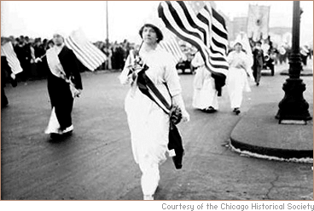
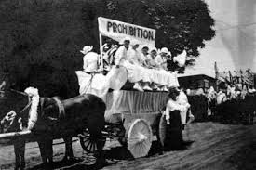
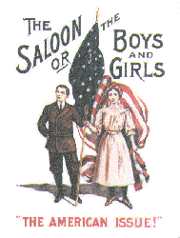
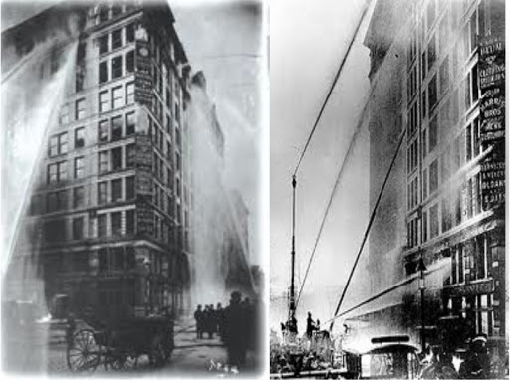
The Progressive Era

Slide 2
Daily opener
What were 4 of the main issues citizens are concerned about when voting?

Slide 3
Daily opener
Name three of the most fascinating Presidents.
Why did you select each one?

Slide 4
US. 10 Analyze the similarities and differences between the ideologies of Social Darwinism and Social Gospel.

Slide 5
Social Gospel vs. Social Darwinism
Christian faith practiced as a call not just to personal conversion but to social reform.
The theory that individuals, groups, and peoples are subject to the same Darwinian laws of natural selection as plants and animals. Now largely discredited, social Darwinism was advocated by Herbert Spencer and others in the late 19th and early 20th centuries and was used to justify political conservatism, imperialism, and racism and to discourage intervention and reform.

Slide 6
Reading Activity:
US. 12 Explain the characteristics and impact of the Granger Movement and Populism, including the problems between farmers and the railroads, the call for banking reform, support for a graduated income tax, and regulation of public utilities.
Read article aloud on the Grange Movement
http://www.gilderlehrman.org/history-by-era/populism-and-agrarian-discontent/resources/grange-movement-1875

Slide 7
US. 17 Analyze the goals and achievements of the Progressive movement, including the following: Adoption of the initiative, referendum, and recall, adoption of the primary system, 16th amendment, 17th amendment, and impact on the relationship between the citizen and the government.

Slide 8
Daily opener
List three political reforms that occurred during the Progressive Era and pick one to describe.
Which TN leader was AGAINST women’s suffrage?

Slide 9
US.19 Analyze the significant progressive achievements during the administration of Woodrow Wilson, including his New Freedom, the Underwood Tariff, the Federal Reserve Act, and the Clayton Anti-Trust Act.

Slide 10
US.21 Analyze the impact of the Great Migration of African Americans that began in the early 1900s from the rural South to the industrial regions of the Northeast and Midwest.

Slide 11
The Progressive Era
1890-1920
Turn of the 20th century
Time of political, social, and economic change and reform in the US

Slide 12
Progressives
Those who supported reforms during the Progressive Era
Tended to be white, middle class, and Protestant

Slide 13
Progressives
Called for regulation of business, improved wages for worker, and regulations over work environments

Slide 14
Progressive
Raged against upper class
Looked down on lower class

Slide 15
1. Women’s Suffrage
US.18 Describe the movement to achieve suffrage for women, including its leaders, the activities of suffragettes, the passage of the 19th amendment, and the role of TN in the suffrage effort (Anne Dallas Dudley, Harry Burn, Josephine Pearson, ‘Perfect 36’)

Slide 16
1. Women’s suffrage
Suffrage – right to vote
Susan B. Anthony – most recognized leader of the movement
Organized rallies and parades
19th amendment officially became part of the US constitution in 1920

Slide 17
Susan B. Anthony
http://www.biography.com/people/groups/activists-womens-rights-activists

Slide 18
Recognize the role of TN in the women’s

Slide 19
A. The Perfect 36
Tennessee and the states before it that voted in favor of women’s suffrage became known as the perfect 36

Slide 20
B. Anne Dallas Dudley
Important activist in the women’s suffrage movement
Played a key role in campaigning for the ratification of the 19th amendment

Slide 21
C. Harry Burn
TN General Assembly locked in a tie
Burn planned to vote NO until he received a letter from his mother.
He voted in favor of women’s suffrage and the 19th amendment had the ‘perfect 36’ necessary to become part of the constituion

Slide 22
D. Josephine Pearson
Born in McMinnsville, TN
Leader of the anti-suffrage movement in TN
Teacher and administrator, held a Master’s Degree

Slide 23
Daily Opener
What was Tennessee’s role in the women’s suffrage movement?

Slide 24
How did Progressivism happen?
https://www.youtube.com/watch?v=tfUYi8ehLMk&list=PLX32WBn4JAMIOp6lLEFvOU96YfuA8bZSs
(pass out handouts)

Slide 25
Finish Questions on W.E.B. Du Bois
The Souls of Black Folk

Slide 26
2. Regulation of food and drug
1906 Congress passed the Pure Food and Drug Act and the Meat Inspection Act
Regulated the food and drug industries
Required accurate labeling of ingredients, strict sanitary conditions, and a rating system for meats

Slide 27
Led to the creation of the Food and Drug Administration- FDA
FDA – still in charge of safety regulations

Slide 28
The Jungle – Upton Sinclair
Exposed nasty meatpacking conditions
https://www.youtube.com/watch?v=Xxe9nosWawM

Slide 29
3. Political Reforms

Slide 30
US.17 Analyze the goals and achievements of the Progressive Movement, including the following:
Adoption of the initiative, referendum, and recall
Adoption of the primary system
16th amendment
17th amendment
Impact of the relationship between the citizen and the government

Slide 31
Finish Progressive Era clip
https://www.youtube.com/watch?v=i0Q4zPR4G7M
Longer Progressive Clip:
https://www.youtube.com/watch?v=z-ztBdclkYU&list=PLX32WBn4JAMKZFHC8NExGT2BKijKYp3h4

Slide 32
a. Initiative
Allowed citizens to force a vote on certain issues without having to wait on public officials to bring it up.

Slide 33
b. Referendum
Citizens could vote directly on proposed laws rather than having political leaders make all of the decisions

Slide 34
c. Recall
Citizens have the power to remove officials from office

Slide 35
d. Adoption of the primary system

Slide 36
d. 16th amendment
An amendment to the US Constitution, ratified in 1913, authorizing Congress to levy a tax on incomes
https://www.youtube.com/watch?v=axKDFOVWb6c

Slide 37
e. 17th amendment
An amendment to the US Constitution providing for the election of two US Senators from each state to be selected by popular vote and a term of 6 years

Slide 38
Impact on the relationship between the citizen and the government
What was it?

Slide 39
Research Groups & Impromptu Presentations over: (standard US.15)
Samuel Gompers
Eugene Debs
Haymarket Affair
Pullman Strike
Coal Creek Labor Saga
Blacklisting
Open vs. Closed Shop
Research Time = 11 minutes
Write down notes about your topic.
Decide who is going to present which facts to the class.
Everyone needs to talk.
Tell the class the significance of your topic.

Slide 41
US.14 Describe working conditions in industries, including the use of labor by women and children.

Slide 42
4. Protection of workers’ rights
Progressives also demanded reforms in the workplace
1911 Triangle Shirtwaist Factory Fire
146 deaths
Locked exits
Fire escape collapsed
https://www.youtube.com/watch?v=4ulaG9x4GpE

Slide 43
Angry progressives demanded action.
By 1920, most states had established workers accident insurance programs,
Eventually reformers convinced legislators to: set limits on how young workers could be
restricted hours
created safer working conditions

Slide 44
Ending child labor
http://www.history.com/topics/child-labor/videos/the-fight-to-end-child-labor

Slide 45
Most Dangerous Jobs Today

Slide 46
Decreasing
In 1992, 6,217 fatal work injuries occurred.
In 2013, that number dwindled to 4,383.
http://newsfeed.time.com/2014/01/15/these-are-the-top-10-most-dangerous-jobs-in-the-u-s/

Slide 47
US.19
Analyze the significant progressive achievements during the administration of Theodore Roosevelt including the Square Deal, ‘trust busting’, the passage of the Pure Food and Drug Act, the Meat Inspection Act, and support for conservation.

Slide 48
Daily openers
What are some of the most deadly jobs in America?

Slide 49
On a sheet of paper, write:
Your name, period, date
Topic of your project
At least 20 good facts on your topic
The answers to the following questions:
Why is your topic important to history?
What impact did your topic/event make on history?
How is your topic still impacting the world today?

Slide 50
Progressive Era Presidents
Number | Name | Terms | Party
25th | William McKinley | 1897-1901 | Republican
26th | Theodore Roosevelt | 1901-1909 | Republican
27th | William Howard Taft | 1909-1913 | Republican
28th | Woodrow Wilson | 1913-1921 | Democrat

Slide 51
5. Antitrust Supreme Court decisions
Rockefeller and several associates created the Standard Oil Trust in 1890
Controlled the oil industry
Severely limited market competition
Many Americans demanded government intervention.

Slide 52
In response, Congress passed the Sherman Antitrust Act
Did not allow any combination of companies that would limit trade and commerce
During the Progressive Era, a number of trusts ended after the government challenged them in court.

Slide 53
6. Progressive Era Presidents
Number | Name | Terms | Party
25th | William McKinley | 1897-1901 | Republican
26th | Theodore Roosevelt | 1901-1909 | Republican
27th | William Howard Taft | 1909-1913 | Republican
28th | Woodrow Wilson | 1913-1921 | Democrat

Slide 54
“I do not believe there ever was any life more attractive to a vigorous young fellow than life on a cattle ranch in those days. It was a fine, healthy life, too; it taught a man self-reliance, hardihood, and the value of instant decision ... I enjoyed the life to the full.”
—Theodore Roosevelt

Slide 55
m

Slide 56
http://www.history.com/this-day-in-history/theodore-roosevelt-shot-in-milwaukee

Slide 57
Theodore Roosevelt
Born in New York
Sickly childhood
doctors discovered that he had a weak heart and advised him to get a desk job and not strain himself
Affluent family

Slide 58
After his dad’s death, Teddy threw himself into his studies at Harvard and later at Columbia Law School.
On February 14, 1884, his mother and wife died.
He would later remarry Edith Carow, a childhood friend, and land the prestigious job as the Assistant US Navy Secretary but resigned from that post to lead a volunteer unit known as the Rough Riders in battle during the Spanish American War (1898).

Slide 59
He led in a bold charge up San Juan Hill in the Battle of San Juan Heights, in 1898.
A war hero, and nominated for the Medal of Honor, Roosevelt was elected governor of New York in 1898.

Slide 60
Was McKinley’s VP
McKinley was assassinated by an anarchist making Teddy the youngest President ever

Slide 61
Teddy was also nicknamed the ‘Trust Buster’
dedicated to prosecuting monopolies under the Sherman Antitrust Act
"Square Deal"—a domestic program that embraced
reform of the American workplace
government regulation of industry and consumer protection
with the overall aim of helping all classes of people

Slide 62
the first president to entertain an African-American, Booker T. Washington, as a guest at the White House
deemed the country's first environmentalist president
Published 25 books about a range of subjects, including history, biology, geography and philosophy

Slide 63
Conservation
Roosevelt protected wildlife and public lands by creating the U.S. Forest Service and establishing 51 Federal Bird Reservations, 4 National Game Preserves, 150 National Forests & 5 National Parks.
TR protected approximately 230,000,000 acres of public land.

Slide 64
Theodore Roosevelt
http://www.biography.com/people/theodore-roosevelt-9463424
Page 234-25 infographic

Slide 65
Reading Quiz
1. While the focus on ________________________________ as the agent of change was a hallmark of this early twentieth century reforming spirit, there was never a singular ideology underpinning the reform activities. (This was a theme during the essay pertaining to its role in protecting the human welfare.)
2. List three characteristics used to generally describe the Progressives.
3. Who was a pioneer of photojournalism who compiled photographic images of NYC's slums in How The Other Half Lives?
4. List 3 reformers mentioned in the article.
5. Describe the incident that occured in 1911 and why this angered Progressives.

Slide 66
Quiz- You may use notes.
List three political reforms that occurred during the Progressive Era.
Describe one of the political reforms.
Who wrote The Jungle?
4. What were two reforms made for workers during the Progressive Era?
5. When was the Progressive Era?
6. Generally, progressives were white, ______________, and ________________.

Slide 67
Ryan, Sydney, Ruchi, Mario | Women make progress page 221 Stop at Reformers Champion Working Women’s Rights
Ben, Blake, Zach, Juan | Women Work for Changes in Family Life Stop at Women Fight for the Right to Vote But include the Ida B. Wells History Makers Box
Justin, Aaron, Robby, Chris | Women Fight for the Right To Vote & Catt Takes Charge of the Movement
Zach C, Sadie, Tobias, Alexis | Activists Carry on the Struggle
Wade, Jeremiah, Jasmine, Michelle | The Nineteenth Amendment Becomes Law
Everyone | Look at Suffragists Win the Right to Vote on pages 224-225
5th needs to complete

Slide 68
Groups: Ch. 8 Sect. 4 starts on page 233
Group Members | Section & Assignment
Ryan, Sydney, Ruchi, Mario | Roosevelt’s Square Deal – stop at Trustbusting and Regulating Industry
Ben, Blake, Zach, Juan | Trustbusting & Regulating Industry (just page 235)& Infographic on pgs. 234-235
Justin, Aaron, Robby, Chris | Roosevelt Enforces the Sherman Antitrust Act & Regulating Food and Drug Industries
Zach C, Sadie, Tobias, Alexis | The Government Manages the Environment & National Land Conservation (237) stop at Roosevelt Changes Water Policy
Wade, Jeremiah, Jasmine, Michelle | Roosevelt Changes Water Policy to Roosevelt Strikes Back
 | READ THE ASSIGNED SECTION. ANSWER: Evaluate the main themes and people from your section. Be prepared to summarize for the class. What significance to history did these events/people play? Are there any similarities to today?

Slide 69
As a group, answer questions 3-7
Turn in
Discuss

Slide 70
US.16 Citing textual evidence as appropriate, explain the significant roles played by muckrakers and progressive idealists, including
Robert La Follette
Ida Tarbell
Lincoln Steffens
Upton Sinclair

Slide 71
7. Muckraker
Investigative journalist who exposed corruption

Slide 72
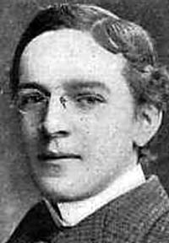
Upton Sinclair
Upton Sinclair
Exposed working conditions and poor sanitation in the meat packing industry
The Jungle

Slide 73
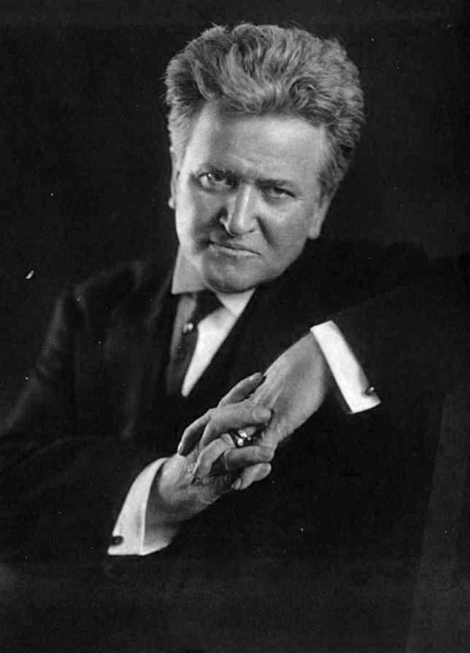
Robert La Follette
Civil Rights Activist
Women's Rights Activist
Anti-War Activist
U.S. Representative

Slide 74
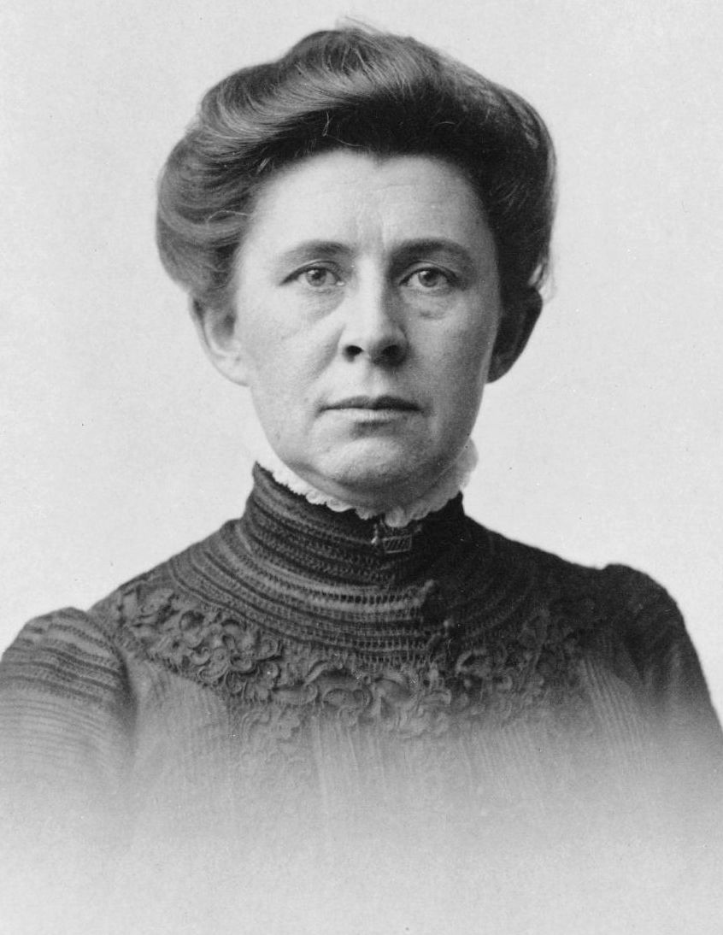
Ida Tarbell
Ida Tarbell was an American journalist best known for her pioneering investigative reporting that led to the breakup of the Standard Oil Company’s monopoly.

Slide 75
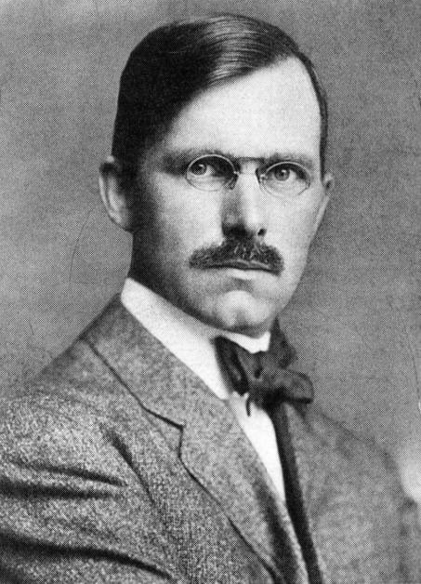
Lincoln Steffens
Journalist
Steffens's particular niche was the relationship between corruption and government

Slide 76
Step 1:Research & Create a Short Biography over your assigned person. Include their career, ideas, and accomplishments. Facts like the date of their birth and their spouse’s name are not needed for this bio. Be sure to include facts about your person’s career and ideas on the Progressive Era.

Slide 77
Levels of Compatibility
If you saw them at Wal-Mart, what would you do?
5- Extremely Compatible
Scream for joy and Hug them
4- Very Compatible
Wave Excitedly
3-Compatible
Smile
2-Kinda Compatible
Half a head nod
1-Not Compatible at all
Run and hide behind the greeting cards
5 – Extremely Compatible
4-Very Compatible
3- Compatible
2- Kinda Compatible
1- Not Compatible at all

Slide 78
Agenda
Daily opener
Finish speed dating game
You and your partner give us a quick summary of your person.
Who were you most compatible with?
Least?
Finish Notes & Clips
Tuesday/Wednesday – Project Work Day, Bring all of your materials to class!
Lauren & Sierra – I need to talk to you.

Slide 79
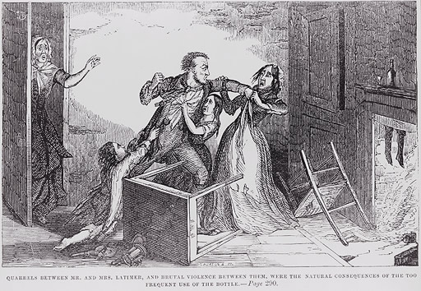
Daily Opener
Describe what you think is happening in the picture.

Slide 80
8. Temperance Movement
By 1830, the average American over 15 years old consumed nearly seven gallons of pure alcohol a year. (3xs today’s average)
Alcohol abuse (primarily by men) was wreaking havoc on the lives of many, particularly in an age when women had few legal rights and many were utterly dependent on their husbands for sustenance and support.

Slide 81
http://www.pbs.org/kenburns/prohibition/roots-of-prohibition/
First video on left

Slide 82
Many abolitionists, who were fighting to end slavery, began to see drinking as an evil as well.

Slide 83
US.37 Explain the background of the Temperance Movement, the passage of the 18th amendment to the Constitution and the Volstead Act, the impact of Prohibition on American society and its successes and failures, including the rise of organized crime, bootlegging and speakeasies, and repeal by the 21st amendment.

Slide 84
8. Temperance Movement
wanted to make alcoholic drinks illegal
In 1919, supporters of the temperance movement won passage of the 18th amendment which would become known as Prohibition.
Prohibited the sale and manufacturing of alcohol
Only amendment to be repealed
http://www.history.com/topics/womens-history/womans-christian-temperance-union/videos/america-goes-dry-with-prohibition

Slide 85
http://www.pbs.org/kenburns/prohibition/roots-of-prohibition/

Slide 86
Al Capone
Coroner’s Report – Al Capone

Slide 87
http://www.biography.com/people/marcus-garvey-9307319

Slide 88
9. African Americans and the Progressive Era
Different leaders within the African American community arose in the late 19th and early 20th century. Although, they shared a common goal of improving the lives of African Americans they often differed over how to best achieve such goals.

Slide 89
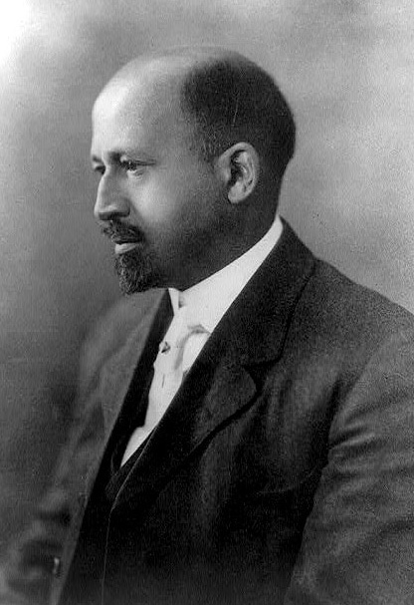
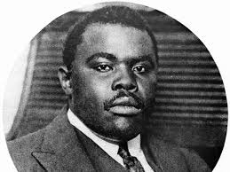
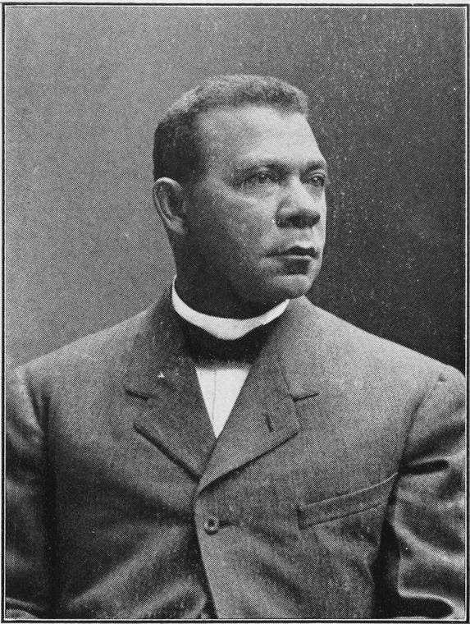
Booker T. Washington
Atlanta Compromise
Accepted segergation
W. E. B. Du Bois
The Souls of Black Folk
Helped found NAACP
Marcus Garvey
?

Slide 90
Marcus Garvey
orator for the Black Nationalism and Pan-Africanism movements. Garvey advanced a Pan-African philosophy which inspired a global mass movement, known as Garveyism.

Slide 91
African Americans and the Progressive Era (1890-1920)

Slide 92
Shared a common goal of improving the lives of African Americans
Often differed over how to best achieve such goals

Slide 93
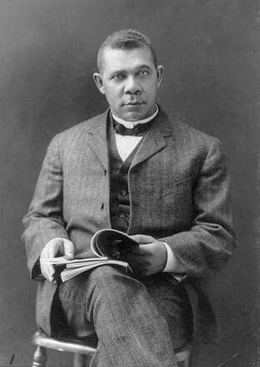
Booker T. Washington 1856 - 1915
“I will permit no man to narrow and degrade my soul by making me hate him.” ― Booker T. Washington
“No race can prosper till it learns that there is as much dignity in tilling a field as in writing a poem.” ― Booker T. Washington

Slide 94
Booker T. Washington
Formerly a slave
Founded Tuskegee Institute after the Civil War
Tuskegee trained African Americans to master a trade so that they could achieve economic freedom.
Encouraged AAs to work as teachers, farmers, and manual laborers so they could gain economic independence

Slide 95
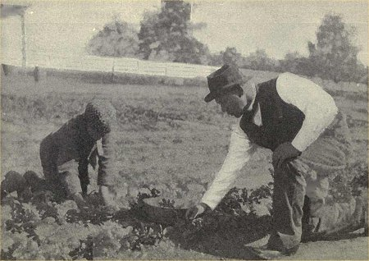
Atlanta Compromise – Speech Booker gave in Atlanta
“In all things that are purely social we (whites and blacks) can be as separate as the fingers, yet one as the hand in all things essential to mutual progress.”

Slide 96
Booker T. Washington
Accepted segregation
Believed African Americans needed to become self-sufficient in a segregated society
pull yourself up by your bootstraps”
http://www.biography.com/people/booker-t-washington-9524663/videos/booker-t-washington-mini-biography-11188803909

Slide 97
W. E. B. Du Bois
Rejected much of Booker T. Washington’s philosophy
Believed blacks should strive for success in academic fields, intellectual pursuits, and white collar jobs
Resented segregation
Harvard’s first African American PhD graduate
Helped establish the NAACP (National Association for the Advancement of Colored People)

Slide 98
W.E.B. Du Bois
“Now is the accepted time, not tomorrow, not some more convenient season. It is today that our best work can be done and not some future day or future year. It is today that we fit ourselves for the greater usefulness of tomorrow. Today is the seed time, now are the hours of work, and tomorrow comes the harvest and the playtime.”

Slide 99
W. E. B. Dubois
http://www.biography.com/people/web-du-bois-9279924/videos/web-du-bois-mini-biography-15383107870

Slide 100
Du Bois Primary Source & Questions
The Souls of Black Folk
Audio: https://www.youtube.com/watch?v=uWEQOwbgyYk

Slide 101
Du Bois Questions
What is the “other world”?
What is the problem that Du Bois is rarely asked and rarely answers?
Why do the questions go unasked?
What metaphors does Du Bois use to describe the difference he feels between his world and the ‘other world’?
How did Du Bois view the ‘other world’?
What is the double consciousness that Du Bois describes?
Metaphor- a figure of speech in which a word or phrase is applied to an object or action to which it is not literally applicable.
"“I had fallen through a trapdoor of depression,” said Mark, who was fond of theatrical metaphors"

Slide 102
What is the “other world”?

Slide 103
What is the problem that Du Bois is rarely asked and rarely answers?

Slide 104
Why do the questions go unasked?

Slide 105
What metaphors does Du Bois use to describe the difference he feels between his world and the ‘other world’?

Slide 106
How did Du Bois view the ‘other world’?

Slide 107
What is the double consciousness that Du Bois describes?

Slide 108
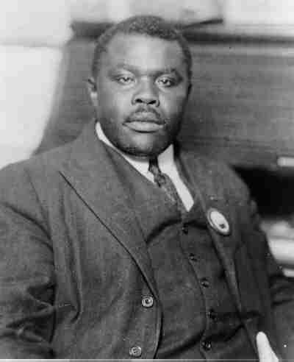
Marcus Garvey
Jamaican by birth
Inspired a great sense of racial pride among African Americans
Amassed a following of more than 500,000 people

Slide 109
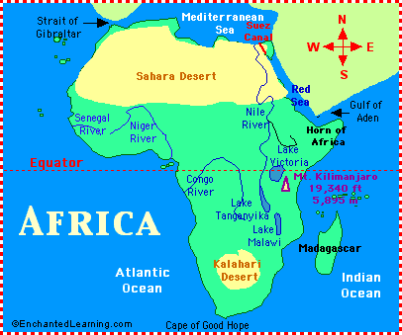
Marcus Garvey
“Back to Africa movement”
Advocated blacks leave the US to found a homeland in Africa
http://www.biography.com/people/marcus-garvey-9307319/videos/marcus-garvey-mini-biography-11191875521

Slide 110
Progressive African American Leader today?

Slide 111
Relevance to Today
Watch clip
http://www.washingtonpost.com/politics/decision2012/president-obamas-acceptance-speech-full-transcript/2012/11/07/ae133e44-28a5-11e2-96b6-8e6a7524553f_story.html

Slide 112
Partner Quiz
Which Progressive black leader was a slave as a child?
Which leader helped found NAACP?
Which leader encouraged all African Americans to move back to Africa?
Which leader was strongly against segregation?

Slide 113
Reflective Writing: African Americans in America Today
Briefly write about the progressive black leaders from our notes. Evaluate America’s reaction to electing a black man to a second term as President. Does race matter in the US today? Are some whites still racist? Are some blacks still racist? Have you ever been the target of racism? Create solutions to ending racism in America for your generation. How will you ensure that your children are not racist?

Slide 114
Paper Organization
Write About
Progressive Black Leaders during the Progressive Era and Today
Booker T. Washington
W.E.B. Du Bois
Marcus Garvey
President Obama
Racism Today
Is it still around?
Have you ever been the victim of racism or guilty of being racist?
Solutions to Future Racism
Ending stereotypes
Not putting up with it
Not encouraging it yourself

Slide 115
US.21 Analyze the impact of the Great Migration of African Americans that began in the early 1900s from the rural South to the industrial regions of the Northeast and Midwest.

Slide 116
Great Migration
The Great Migration, or the relocation of more than 6 million African Americans from the rural South to the cities of the North, Midwest and West from 1916 to 1970, had a huge impact on urban life in the United States.
Driven from their homes by unsatisfactory economic opportunities and harsh segregationist laws, many blacks headed north, where they took advantage of the need for industrial workers that first arose during the First World War.

Slide 117
Great Migration
http://www.history.com/topics/black-history/great-migration
Image & article (notes cover article)

Slide 118
Great Migration
As Chicago, New York and other cities saw their black populations expand exponentially, migrants were forced to deal with poor working conditions and competition for living space, as well as widespread racism and prejudice.
During the Great Migration, African Americans began to build a new place for themselves in public life, actively confronting economic, political and social challenges and creating a new black urban culture that would exert enormous influence in the decades to come.

Slide 119
As a result of housing tensions, many blacks ended up creating their own cities within big cities, fostering the growth of a new urban African-American culture.
The most prominent example was Harlem in New York City, a formerly all-white neighborhood that by the 1920s housed some 200,000 African Americans.

Slide 120
Harlem Renaissance
The black experience during the Great Migration became an important theme in the artistic movement known first as the New Negro Movement and later as the Harlem Renaissance, which would have an enormous impact on the culture of the era.
The Great Migration also began a new era of increasing political activism among African Americans, who after being disenfranchised in the South found a new place for themselves in public life in the cities of the North and West.

Slide 121
Harlem Renaissance
http://www.history.com/topics/black-history/great-migration/videos/the-harlem-renaissance

Slide 122
Just the Facts: The emergence of modern America
Great review clip over Progressive Era
30 minutes

Slide 123
Page 229
Answer Compare questions 1 and 2

Slide 124
US.20 Analyze the significant progressive achievements during the administration of Woodrow Wilson, including his New Freedom, the Underwood Tariff, the Federal Reserve Act, and the Clayton Anti-trust Act.

Slide 125
New Freedom

Slide 126
The Underwood Tariff

Slide 127
The Federal Reserve Act

Slide 128
The Clayton Anti-Trust Act

Slide 129
7.4 Identify the causes of American involvement in World War I (i.e., security concerns, economic benefits, Wilsonian diplomacy, propaganda).

