Slide 1
Daily Openers
In one to three sentences, answer the questions, “What is history?”

Slide 2
Lies My Teacher Told Me
James West Davidson and Mark H. Lytle wrote After the Fact which emphasizes that history is not a set of facts but a series of arguments, issues, and controversies.

Slide 4
Founding the New Nation

Slide 5
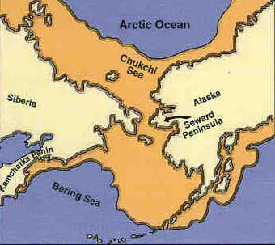
Ye Old Thought
People began crossing the Bering Strait about 6,000 years ago.

Slide 6
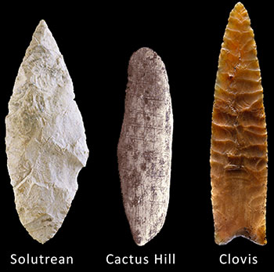
New Thought
People crossed as early as 35,000 years ago
Some archeologists suggest people came from both Asia and Europe.

Slide 7
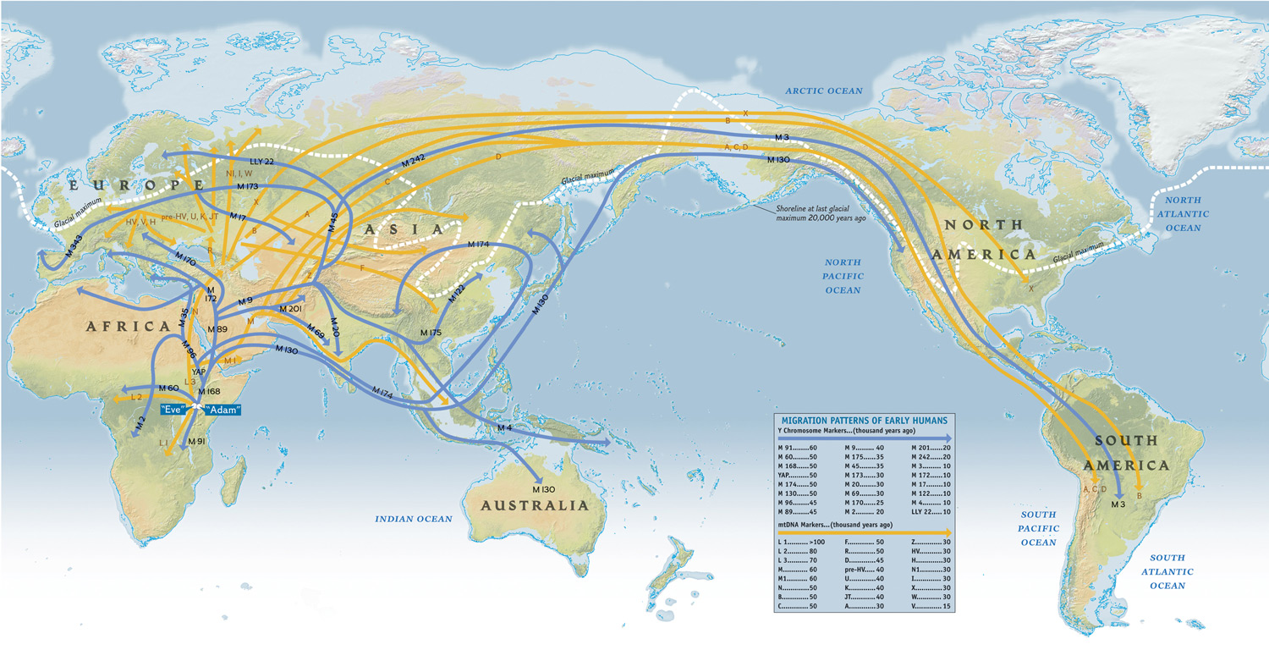
Migration

Slide 8
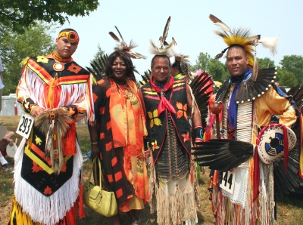
Typical American Opinion

Slide 9
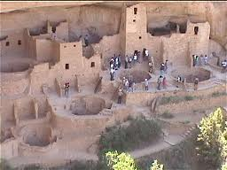
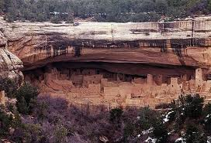
The Anasazi

Slide 10
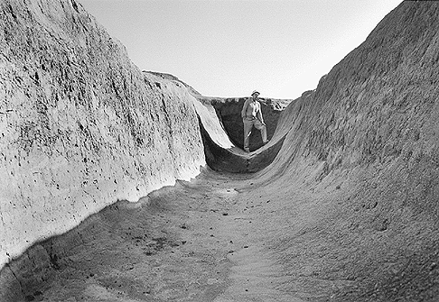
Lifestyle
Lived in the American SW, mainly New Mexico
Dug reservoirs and then dug canals to their crop fields, mainly grew corn
http://www.indians.org/articles/anasazi-indians.html

Slide 11
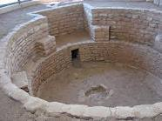
Lifestyle
Lived in massive structures (Pueblos), some had as many as 800 rooms
The Kiva was a circular structure used carry out religious ceremonies.

Slide 12
Societal Structure
At least 25,000 different Pueblos in New Mexico by 1500 A.D.
They did not have a unified government which caused a lack of unity.

Slide 13
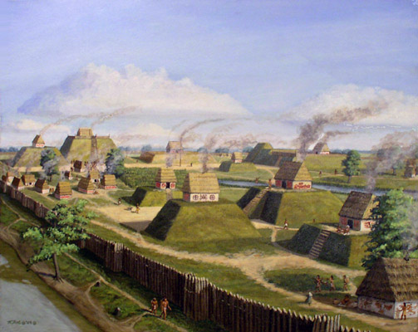
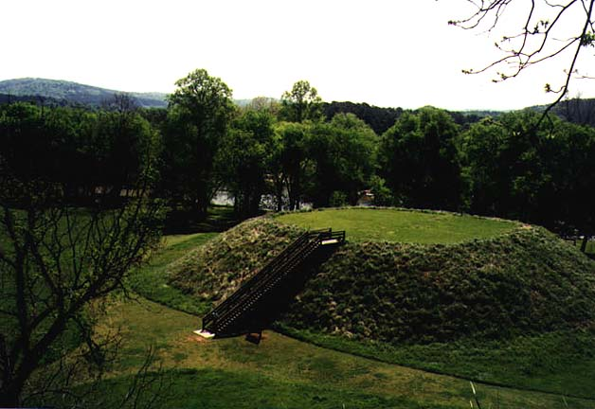
The Mississippian's
Sometimes called the Mound Builders

Slide 14
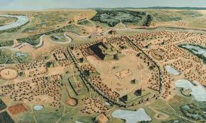
Cahokia
Huge city that had possibly 30-40,000 inhabitants
Many other cities in the surrounding area
http://www.gilderlehrman.org/history-by-era/american-indians/essays/cahokia-pre-columbian-american-city

Slide 15
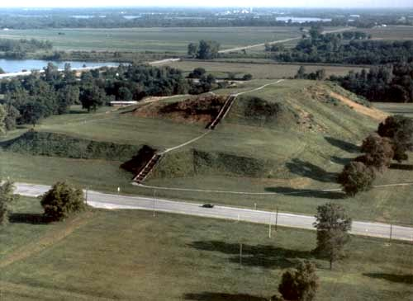
Takes up 16 acres, 100 ft high, and contains roughly 22 million cubic feet of dirt

Slide 16
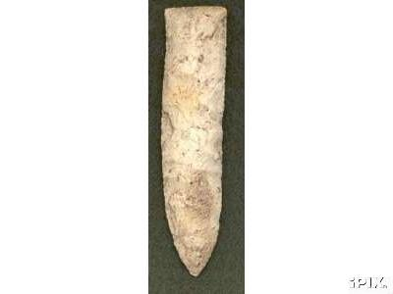
Society
They had vast trade network that covered most of America
The knives they manufactured have been found all over

Slide 17
Society
Around 1300 AD their glorious society fell apart
They became many of the various groups located in the Ohio River Valley

Slide 18
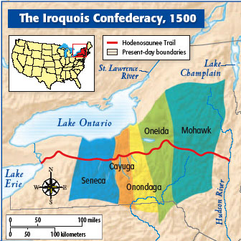
The Iroquois
Huge confederation of 5 different tribes based mainly in New York

Slide 19
Society
Lived in Longhouses
Believed in sharing everything, did not focus on the individual
Divided up crops amongst themselves

Slide 20
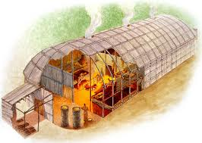
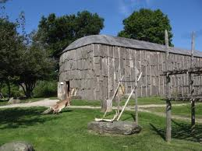

Slide 21
Family Structure
Matrilineal – family lineage passed through mother not father, women have more power
The Matron’s – group of eldest mothers who formed a counsel to decide who the chief was

Slide 22
Native American World View
Believed in protecting the environment
Manitou – belief that there are consequences for mistreating the environment

Slide 23
Africa
Much like North America because there were many groups or tribes
2/3’s of people coming to new world came against their will

Slide 24
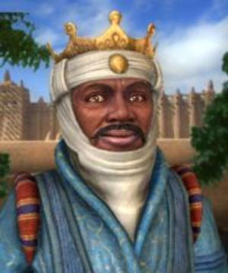
The Mali Empire
Leader Mansa Musa in 1324 traveled 3,500 miles to Mecca
Convinced Muslim scholars to come to his university in Timbuktu

Slide 25
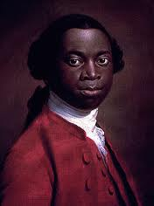
Olaudah Equiano
From what was the Mali Empire
Captured in the Slave Trade

Slide 26
Activity
Research assign Native American group(s)
Research their physical environment, culture, etc…
Show pictures of landscape, art, artifacts, ceremonial dress, etc…

Slide 27
Daily Opener
Name two of the three tribes discussed in the previous lesson
Which Native American group built on top of mounds
Which Native American group built a religious structure called a Kiva

Slide 28
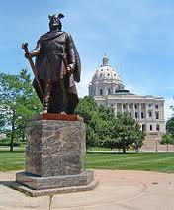
European Discovery of New World
Leif Erikson son of Erik the Red discovered NA around 1000 AD
There is evidence of Viking colonies

Slide 29
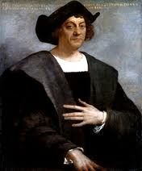
Why Columbus?

Slide 30
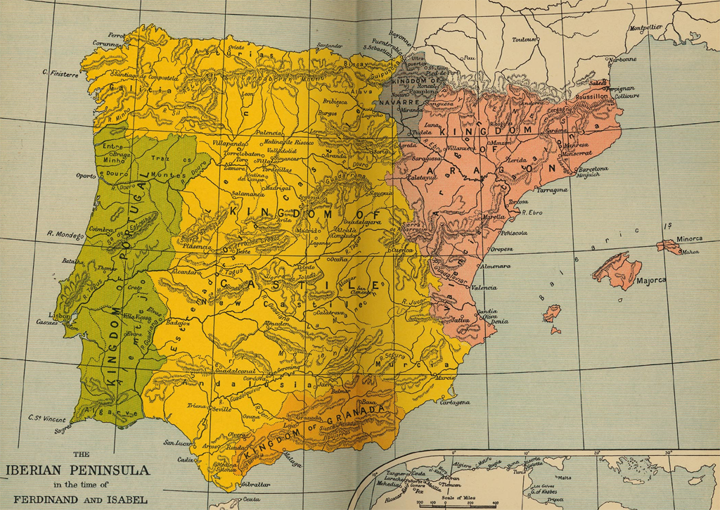
Ferdinand and Isabella
Married in 1469 which united Spain into 1 country

Slide 31
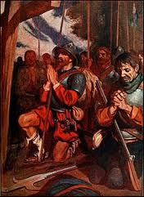
Reconquista
Spain finally drove out the Muslims in 1490
Convinced them God wanted them to Christianize the Muslims, but they would need more soldiers (conquistadores)

Slide 32
Ch. 1 New World Beginnings

Slide 33
Several Billion years ago, the earth came into being.
Recorded history began 6,000 years ago.
500 years ago, Europeans found America.

Slide 34
Most popular theory of how the Americas was populated is that people crossed the Bering land bridge .

Slide 35
Who said -
Following the light of the sun, we left the Old World.

Slide 36
Columbus
Was born in Genoa, Italy
His goal was to reach the East (East Indies) by sailing west, thus bypassing the around-Africa route that Portugal monopolized.
He tried to get funding for his mission for years.
Finally, Columbus convinced Isabella and Ferdinand to fund his expedition.

Slide 37
He misjudged the size of the Earth though, thinking it 1/3 the size of what it was.
So, after 30 days or so at sea, when he struck land, he assumed he'd made it to the East Indies and therefore mistook the people as "Indians."

Slide 38
This spawned the following system:
Europe would provide the market, capital, technology.
Africa would provide the labor.
The New World would provide the raw materials (gold, soil, lumber).

Slide 39
Who was Rodrigo de Triana?

Slide 40
Columbus promised gold to the first sailor to spot land.
Rodrigo de Triana was the first one.
Columbus denied him the prize, saying that he saw land the night before.

Slide 41
Columbus was a wonderful captain but a terrible governor.
He treated the people terrible and stole their gold and valuables.
He was taken back to Spain in shackles after mismanaging Santa Domingo.

Slide 42
Columbus was very religious. Once he returned home, he dressed like a monk instead of a wealthy admiral.
He thought he had discovered the Garden of Eden when he saw the Orinoco River in South America.

Slide 43
Slave-trader
Columbus was disappointed when he realized he would not find an abundance of gold, silver, and other resources in the new world.
He decided that the natives of the strange land could be valuable and began taking them back to Europe.
He was devastated when Queen Isabela demanded he stop capturing her ‘new subjects.’

Slide 44
Columbus clung to the idea that he had NOT discovered a new world but had found an alternate route to Asia.
He even proposed a ridiculous theory: that the Earth was shaped like a pear, and that he had not found Asia because of the part of the pear that bulges out towards the stem.

Slide 45
Where is Columbus buried?

Slide 46
Two cities
Seville, Spain
Santo Domingo (capital of the Dominican Republic) –claim to have his remains. In each city, the bones in question are housed in elaborate mausoleums.

Slide 47
http://www.biography.com/people/christopher-columbus-9254209#video-gallery

Slide 48
http://latinamericanhistory.about.com/od/thevoyagesofcolumbus/tp/Ten-Facts-About-Christopher-Columbus.htm

Slide 49
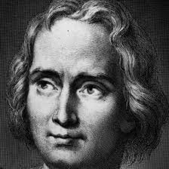
Christopher Columbus
Originally from Italy, but moved to Spain to be a merchant
Married into the Kings court

Slide 50
The Voyage
Reason was for spice trade
Voyage was called “Enterprise of the Indies”
The King issued a charter that allowed Columbus to claim land for Spain

Slide 51
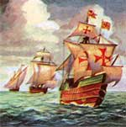
The Ships
The Nina, Pinta, Santa Maria

Slide 52
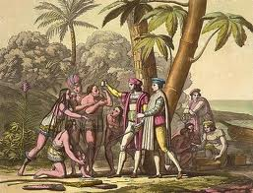
The Discovery
October 12, 1492 Columbus landed and named the island San Salvador (Holy Savior)
Kidnapped 6 Indians and took them to Spain as slaves

Slide 53
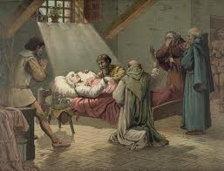
Columbus’s Return
Ferdinand and Isabella sponsor 3 more trips
He dies in 1506 still believing he discovered Asia

Slide 54
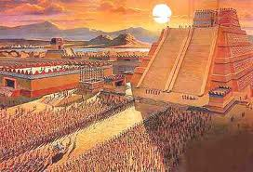
The Spanish “Invasion”
Germs and Viruses
Spanish conquistadors invade with less than 1,000 men and bring the Aztec Empire to its knees in less than a year

Slide 55
The Encomienda System
Spanish system where they demanded tribute from local tribes or face death
Allowed Spanish to enslave populations across Caribbean, South, and Central America

Slide 56
The Columbian Exchange
Historical term for trade between old/new world
1. Disease – to the new world
2. Precious Metals – to old world (gold, silver)
3. Crops – to old world (corn, tobacco)
4. Livestock – to new world (cows, horses, pigs)

Slide 57
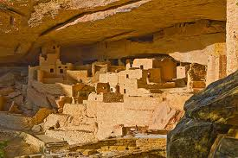
New Mexican Missions
Anasazi were first to encounter Spanish in NA
Spanish sent missionaries to establish contact with them

Slide 58
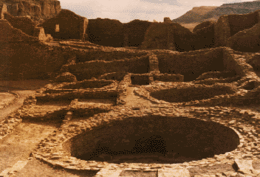
The Encounter
Missionaries destroyed the Kivas and replaced them with churches
They also tried to force them to become Christians

Slide 59
The Pueblo Revolt 1680
Largest rebellion in America until revolution
17,000 Anasazi’s rise up and kill the missionaries and destroy the churches
It takes Spain ½ a century to retake NM area

Slide 60
Research Project
Vasco Balboa
Ferdinand Magellan
Ponce de Leon
Hernando Cortez
Francisco Pizarro
Francisco Coronado
Amerigo Vespucci

