Slide 1
1920’s culture
Sierra Cook
Research Paper
U.S. history
Mrs. Cleveland's
6th period
December 10, 2012

Slide 2
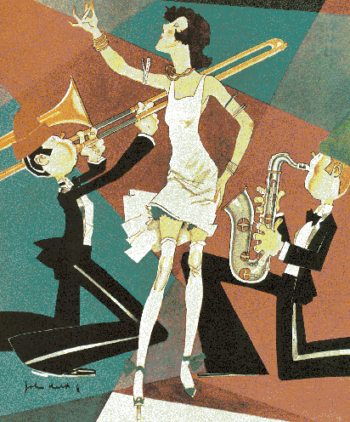
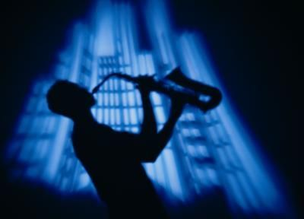
The jazz Age or the Roaring 20’s
What all got big in the 1920s?
Who was a big person in organized crime?

Slide 3
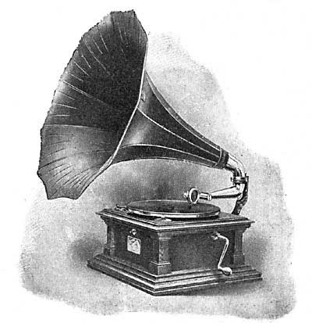
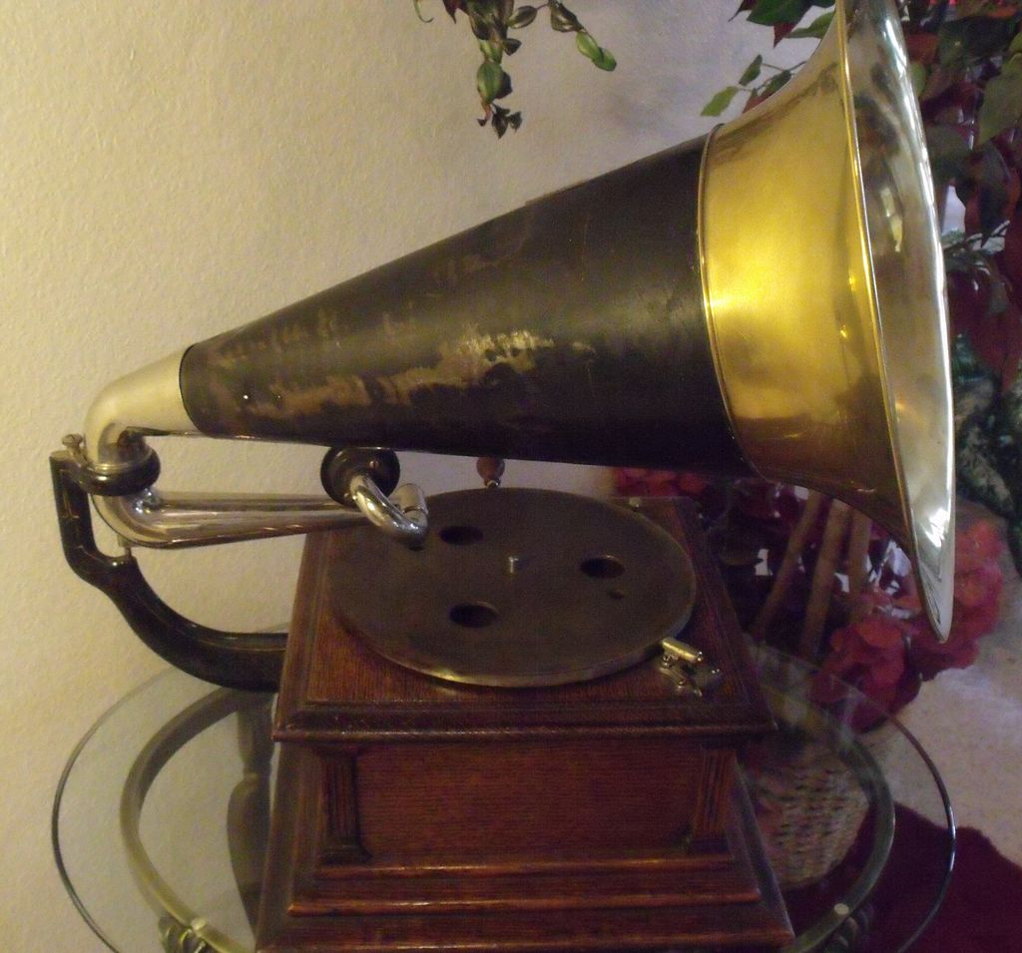
Phonograph
Was a common device for playing sounds starting in the 1870’s
Reached it peak in the 20’s
Had to be hand cranked every 3 or 4 records
110-125$

Slide 4
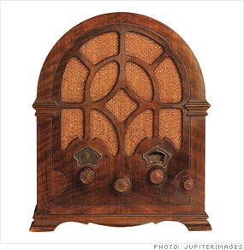
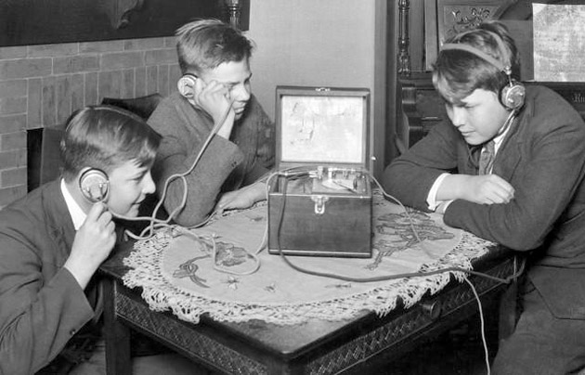
Radio
Guglielmo Marconi, Owen Young, Ed Nally Jr.
Roughly 3 million americans owed a radio by 1923
began being used for the promotion of newspapers
Powerful communications
The Americans knew things faster than before

Slide 5
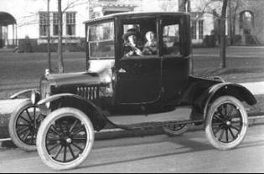
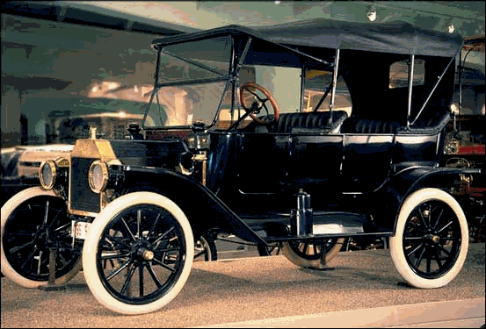
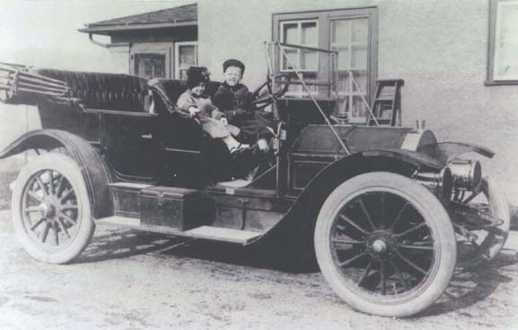
Automobile
Henry Ford
Model-T, 1927
New way of Transportation

Slide 6
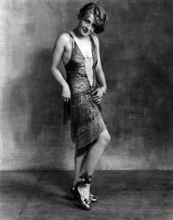
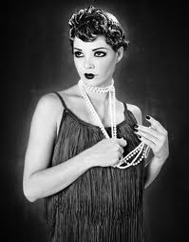
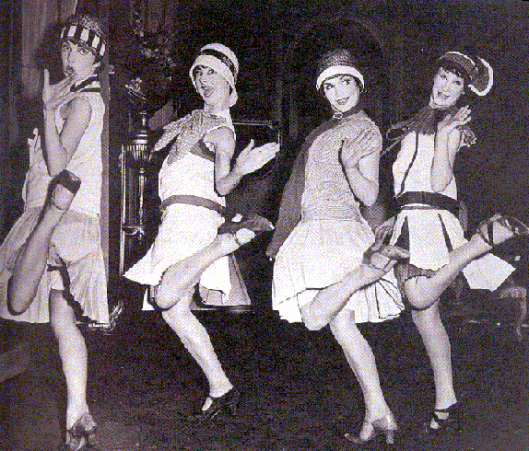
flapper
The term first appeared in Great Britain after World War I. It was there used to describe young girls, still somewhat awkward in movement who had not yet entered womanhood
Short hair
Knee length or shorter skirts
Smoking/drinking

Slide 7
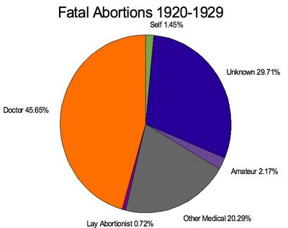
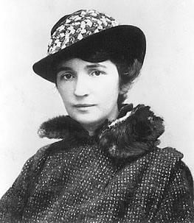
Birth control
Margaret Sanger
Opened up birth control clinics
Women were able to keep their jobs or even get raises or promoted

Slide 8
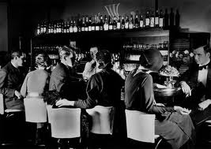
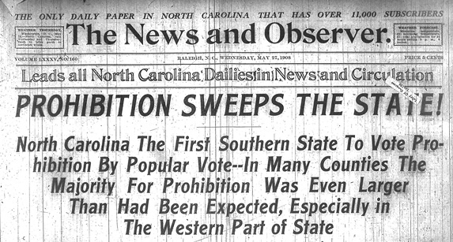
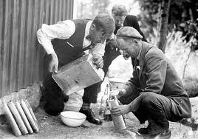
Prohibition
18th amendment
Illegal to sell/make alcohol
Speakeasies/ bootleggers
Hidden saloons-speakeasies
Smuggled in alcohol in-bootleggers

Slide 9
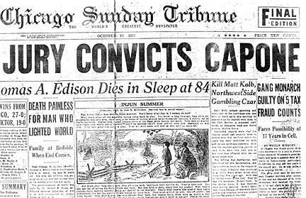
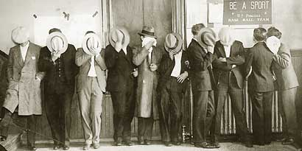
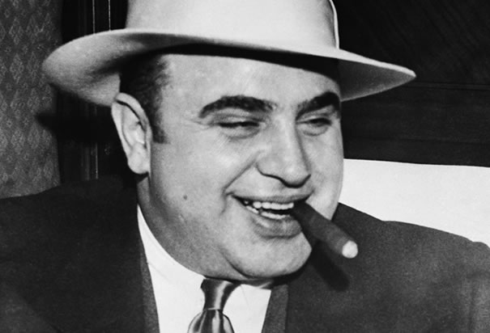
Organized crime
Prohibition helped with the growth of organized crime
Al capone
Chacigo
Bootlegger/pimp
Made at least 60 million a year alone
Killed off his competition
1931 sent to prison for tax-evasion

Slide 10
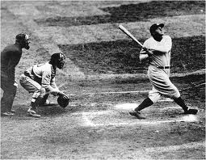
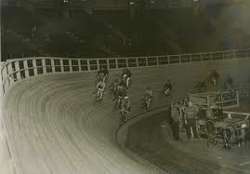
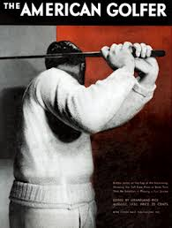
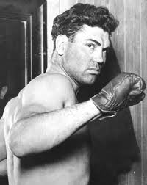
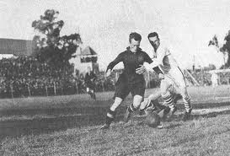
Sports
Baseball
Babe ruth
Boxing
Jack dempsey
Soccer
Golf
Horse derbys

Slide 11
Sources
http://www.enotes.com/1920-media-american-decades/phonograph-records
http://www.radioblvd.com/20sRadio.html
http://history1900s.about.com/od/1920s/a/flappers.htm
http://historymatters.gmu.edu/d/5082/
http://iantyrrell.wordpress.com/alcohol-prohibition-in-the-usa/
http://www.u-s-history.com/pages/h1596.html
http://www.angelfire.com/anime4/sephirothbadazz/Reports/sports.html

